Slide 1

Office of Climate Change and Energy Efficiency
Climate Change Consultations

Slide 2
Why We’re Here
Provincial Government developing new climate change strategy
Consultations important part of this
Details on other ways to participate http://www.gov.nl.ca/TalkClimateChange
Notes:
Good morning/afternoon. Thank you for taking the time to participate in this consultation session.
The Provincial Government has committed to developing a new climate change strategy for Newfoundland and Labrador, and it wants to get your views and ideas to inform the development of this strategy.
We are here today to hear what you think this province should do to address climate change in a way that builds a vibrant, low-carbon economy with strong communities.
This is an opportunity to share ideas about what individuals, families, organizations, communities and governments can do to reduce greenhouse gas emissions and adapt to climate change.
There are other ways to feed into the consultation process, including providing written comments or participating in online consultation sessions. If you are interested in learning more about these, details can be found at www.gov.nl.ca/TalkClimateChange

Slide 3
What we’ll cover
Climate Change Overview
Ground Rules and Introductions
Discussion Topic 1 – Growing the Green Economy
Discussion Topic 2 – Adapting to Climate Change
Discussion Topic 3 – Government Leadership
Next Steps
Notes:
Let me describe how we plan to structure our conversation today.
We’ll kick off by doing some brief introductions and outlining the ground rules for the session.
Then I’ll take about 10 minutes to explain what climate change is.
After this, we’ll move into discussion cycles focused on three topic areas:
Growing the green economy
Adapting to climate change
Government leadership
We’ll take each discussion topic in turn and I’ll start by providing a brief introduction (about 5 minutes) to the discussion topic and then the group will have an opportunity to have an open discussion and share ideas, perspectives and priorities.
We will conclude by touching on next steps following the consultation process.
One final point - the presentation today mirrors the structure of the discussion guide developed by the Province, and as we go through the presentation, I encourage you to refer to the discussion guide for additional information and context if that’s of help.
With that, let’s begin!

Slide 4
Climate Change Overview
A Global Challenge
Scientists are clear
  Global challenge needing global solutions
Governments are committed to act and do their part
  International: Paris Agreement
  National: Pan-Canadian Framework on Climate Change
  Provincial: 2011 Action Plans; New Climate Change Strategy
Notes:
Scientists are clear: climate change is one of the greatest challenges facing the planet and it is being caused by human activities. Climate change requires global action and all jurisdictions, no matter how big or small, must be part of the solution. There are opportunities to stimulate clean economic growth.
In December 2015, over 190 countries met in Paris and adopted an agreement to tackle climate change. As part of this agreement, Canada agreed to cut its greenhouse gas emissions by 30% below 2005 levels by 2030.
In March 2016, the Prime Minister and Premiers from all provinces and territories agreed to develop a pan-Canadian framework on clean growth and climate change. The Government of Newfoundland and Labrador is actively involved in this work. First Ministers will meet again in the fall to agree on the framework.
Targets to reduce Newfoundland and Labrador’s greenhouse gas emissions were set out in the 2011 Climate Change Action Plan. This Plan had a five-year duration so it expires at the end of 2016.
The government has committed to develop a new climate change strategy to determine next steps for our province. The input provided through this and other consultation sessions will feed into that process. It will also help inform government’s engagement in the national conversation with the other provinces and territories and the federal government on a pan-Canadian framework.

Slide 5
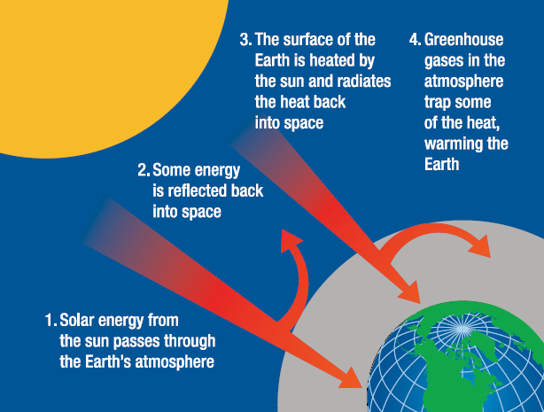
Climate Change Overview
What Causes Climate Change?
Notes:
So let’s recap what climate change is.
The earth is surrounded by a layer of naturally occurring gases known as its atmosphere, which includes water vapour, carbon dioxide, methane and nitrous oxide. These are commonly referred to as "greenhouse" gases because, like the walls of a greenhouse, they trap some of the heat from the sun and this warms the planet and makes it livable. Without these gases, the earth would be too cold to support life.
Over the past 150 years, humans have been adding significantly to our atmosphere by releasing more and more greenhouse gases. Now there is too much of these gases in the atmosphere and global temperatures are rising, causing climates around the world to change.
Global action is needed to prepare for the impacts of climate change and reduce greenhouse gas emissions to avoid worse impacts in future.

Slide 6
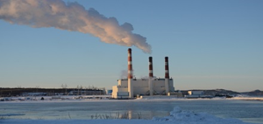

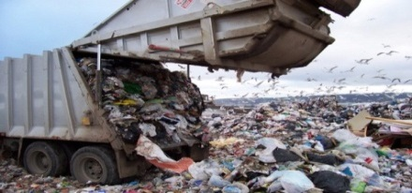


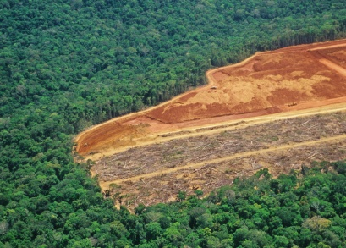
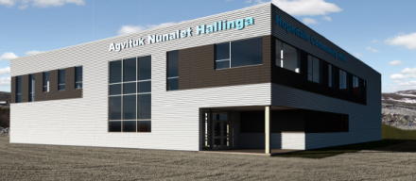

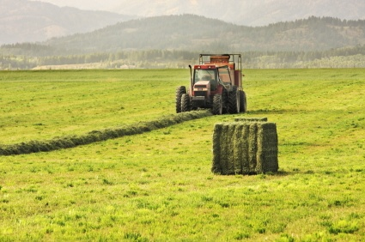
Climate Change Overview
Where do GHGs Come From?
Energy Sources
Non-Energy Sources
Notes:
Greenhouse gases come from both energy sources and non-energy sources.
Energy Sources: Burning fossil fuels such as coal, oil and natural gas to generate energy, to heat our buildings, and to power our vehicles, releases greenhouse gases into the atmosphere and contributes to climate change.
Non-Energy Sources: The decomposition of organic waste in the absence of oxygen, the use of chemical fertilizers, and cutting down trees without replanting them can also release greenhouse gas emissions that contribute to climate change.

Slide 7
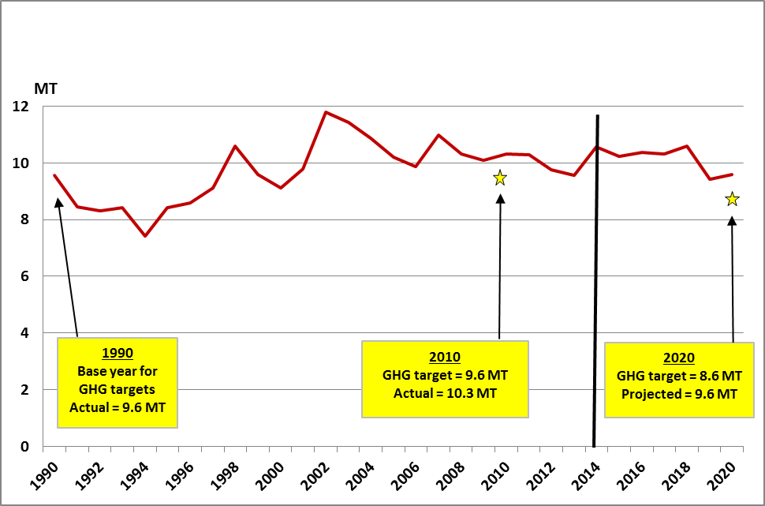
Climate Change Overview
Newfoundland and Labrador GHG Emissions
1990-2014 Actual; 2015-2020 projected
Further action is needed to meet the Province’s 2020 GHG target.
Notes:
The Government of Newfoundland and Labrador has established targets to reduce provincial greenhouse gas emissions.
In the 2011 climate change and energy efficiency action plans, Newfoundland and Labrador committed to reduce its GHG emissions by:
10 per cent below 1990 levels by 2020
75 to 85 per cent below 2001 levels by 2050
Greenhouse gas emissions in NL are around the same level now as they were in 1990. Over this period, the provincial economy grew by about 70 per cent.
Absent further action, the province is not currently on track to meet its 2020 target. The gold stars on the chart show where the 2020 target sits in relation to greenhouse gas projections. Projections indicate that in 2020, the province will still be around 1990 GHG emission levels (rather than 10 per cent below), even with the closure of the Holyrood Generating Station and Muskrat Falls power being available. This is due to growth in the industrial sector.
Given this, further action to reduce greenhouse gas emissions is needed.

Slide 8
Climate Change Overview
Newfoundland and Labrador GHG Emissions
Notes:
So what are the main sources of greenhouse gas (GHGs) emissions in Newfoundland and Labrador?
36% is from large industry which includes:
Oil refining
Mining
Offshore petroleum, and
Pulp and paper industry
34% of GHGs come from transportation (road, marine and air)
11% of GHGs come from power generation. This is mainly Holyrood but includes off-grid remote diesel communities.
9% is from building fuels, mostly fuel oil to heat houses and other buildings
8% comes from waste
The remainder is from other sources including manufacturing and agriculture, at about 1% each.

Slide 9
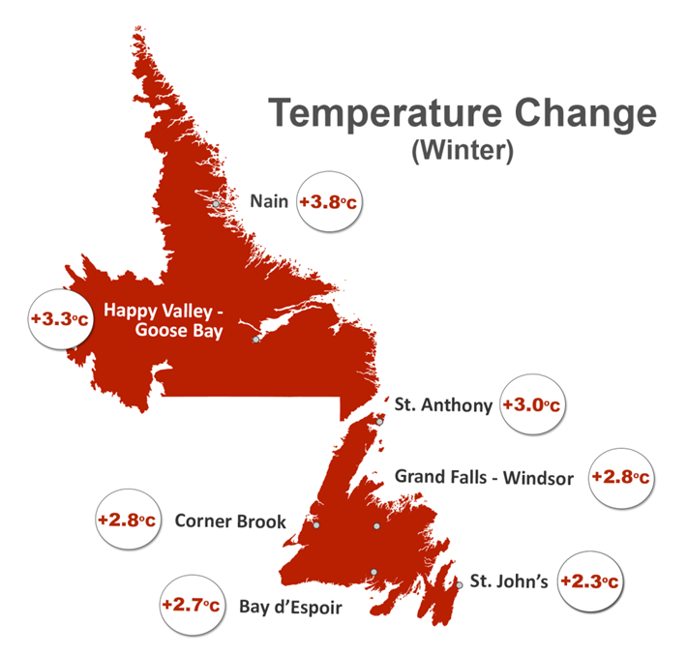
Climate Change Overview Newfoundland and Labrador
Notes:
In the province, climate change is projected to bring weather that is warmer, wetter and stormier.
The province is already about 1.5 degrees Celsius warmer than it was 50 years ago and by 2050, the province is projected to be warmer still.
The map shows projected temperature changes by mid-century for winter. You will notice that the winter temperature changes are significant and that higher increases are expected in more northern areas of as much as 3.8 degrees Celsius.
Let me put this in perspective. At the time of the last Ice Age, about 20,000 years ago, average global temperatures were only five to six degrees lower than what they are today. Now, within less than 100 years, average temperatures could be up to four degrees higher than today.
This warming will bring both opportunities and risks to individuals and all sectors of the economy in Newfoundland and Labrador and around the world. Let’s consider how they are expected to impact this province.

Slide 10
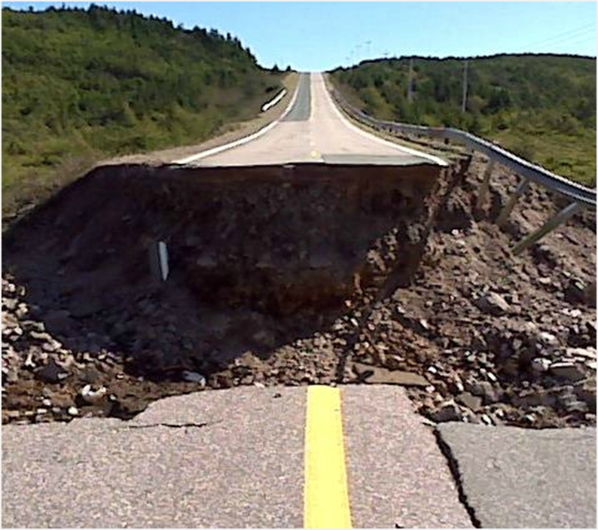
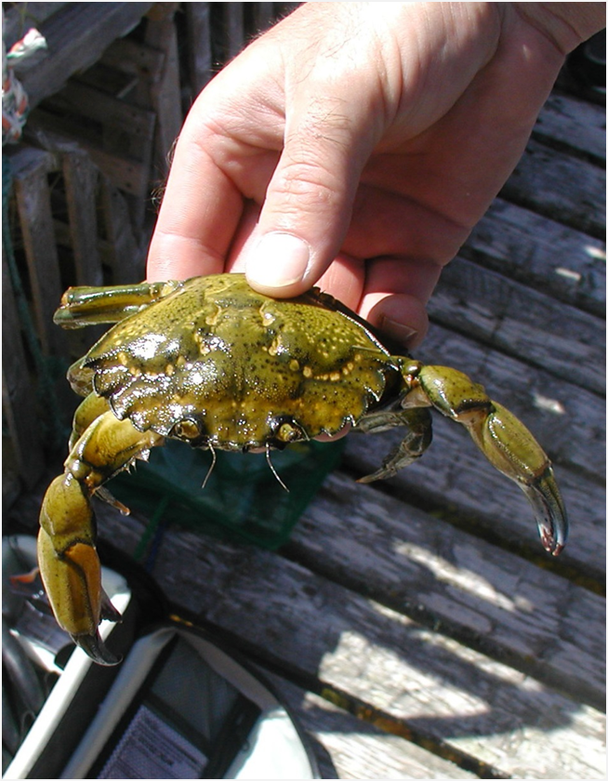


Climate Change Overview Newfoundland and Labrador
Risks:
Infrastructure damage and risks to public safety
Coastal erosion and property damage
New pests and invasive species
Permafrost melt and sea-ice loss in Labrador
Opportunities:
Longer seasons for agriculture, forestry
and aquaculture
Extended summer tourism season
Growth in green economy
Notes:
In terms of risks:
More extreme weather and rainfall will cause increased damage to infrastructure and risks to public safety, such as road washouts.
Higher sea levels and storm surges will increase coastal erosion and could put coastal property at risk.
New pests and diseases may emerge that could affect human or animal health, like Lyme disease, or impact natural resource sectors, such as green crab or pine beetles affecting fisheries and forestry respectively.
Higher temperatures will impact the integrity of infrastructure in Labrador as permafrost, on which many structures are built, melts.
Reduced sea ice will affect human safety and food security as this ice is used for winter transportation routes and access to traditional foods.
We will need to prepare for these risks while at the same taking advantage of new opportunities, such as:
Warmer air and water temperatures may increase growing seasons in some agricultural, forestry and aquaculture industries.
An early onset of summer and milder fall may mean the summer tourism season could start earlier and finish later.
Moves to address climate change will generate opportunities for clean growth, for example, greater demand for greener, more energy efficient buildings, renewable energy, and clean technologies.

Slide 11
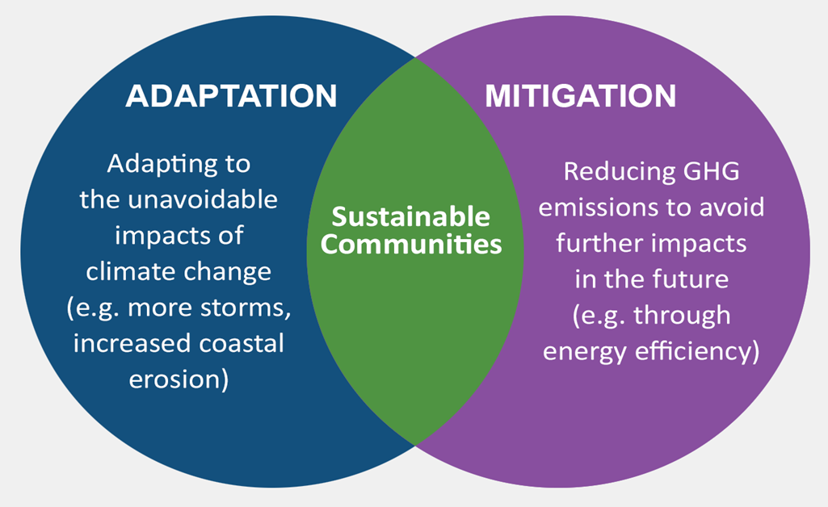
Climate Change Overview
Taking Action
Notes:
Action needs to be taken on two fronts.
We need to prepare for, and adapt to, the impacts of climate change because, as a result of the GHGs already emitted into the atmosphere, temperatures will rise and weather patterns will change. In other words, some unavoidable climate change impacts are already “locked-in” due to historic GHG emissions.
We also need to mitigate GHGs by reducing the amount that is emitted into the atmosphere. This is necessary to prevent worse impacts from climate change in the future.
These two approaches are complementary and must be undertaken in concert. When both approaches are pursued and achieved, the result is stronger, sustainable communities.

Slide 12
Ground Rules and Introductions
Small group roundtable discussions
Comments being recorded and will be made public but no views will be attributed
Please speak openly and honestly
Please respect views expressed by others
Meet your fellow participants!
Notes:
Session will involve small group roundtable discussion. This is intended to allow all participants to have the opportunity to speak, and to allow for interaction among participants.
All of the ideas and perspectives you provide today are being noted and will be sent to the Office of Climate Change and Energy Efficiency for consideration as the strategy is developed. The Office will also include them in a “What We Heard” document that will be publicly released following the consultations.
However, please note that the ideas you share here today will be anonymous. They will not be attributed to any person, group or organization, so please speak openly and honestly.
There is a person at your table with a laptop or notepad and he or she will be taking notes as you speak. This is only to record the content of the discussion, not who said what.
Please respect views expressed by others and allow everyone a chance to participate.
Now I will turn it over to the table facilitators to introduce themselves and give you all an opportunity to introduce yourself to your table.

Slide 13
Discussion Topic 1:
Growing the Green Economy
What is the green economy?
  Wealth and jobs generated by products and services that are environmentally sustainable
Growing the green economy is key to fighting climate change
Global shift towards “green” solutions will bring opportunities for businesses in green technologies, products or services
Notes:
So this brings us to our first discussion topic – how we can reduce our greenhouse gas emissions while taking advantage of opportunities to develop the green economy and create jobs in the province.
The green economy refers to the wealth and jobs generated by products and services that are environmentally sustainable.
The global economy is undergoing a shift towards clean, green technologies. This will create opportunities for business in the green economy both in Newfoundland and Labrador and for export to other parts of the country and around the world.

Slide 14
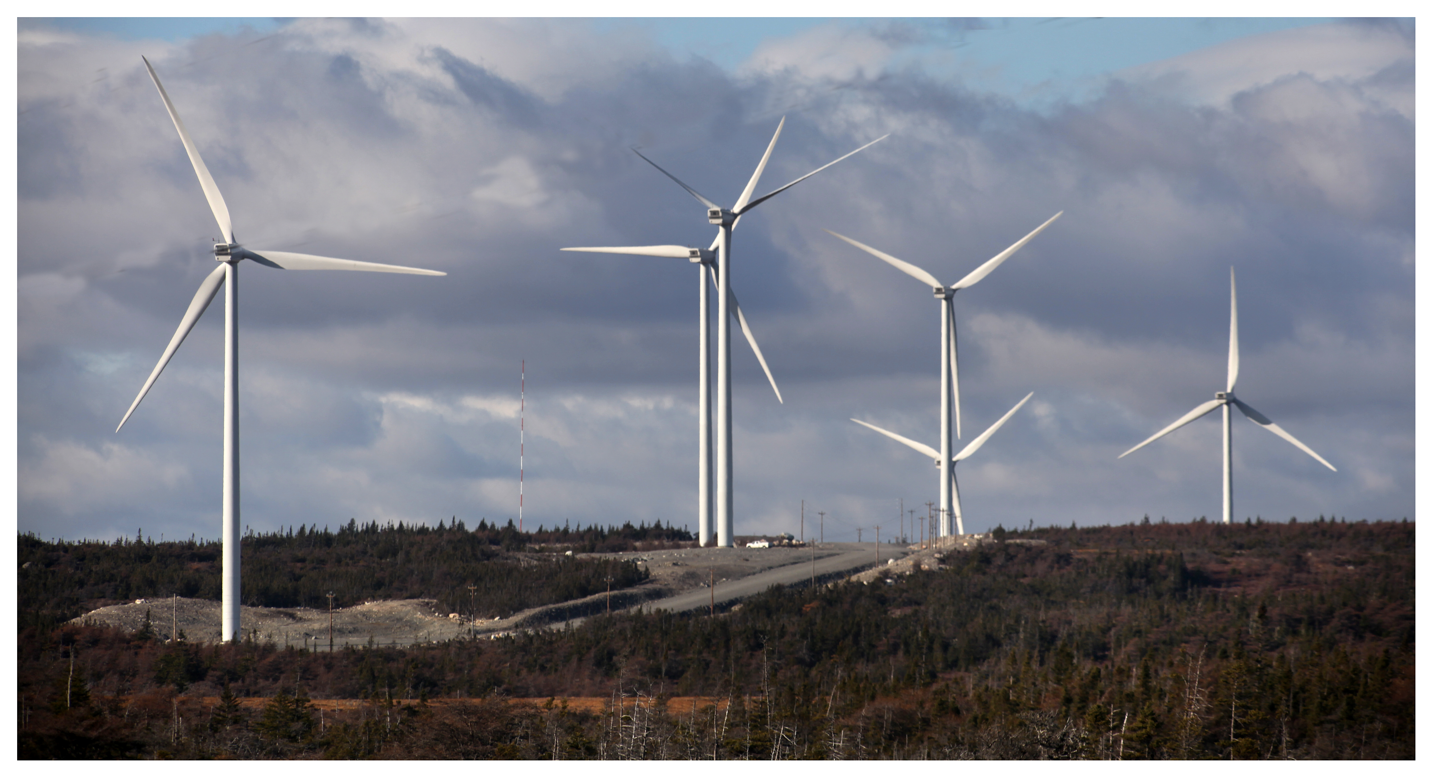


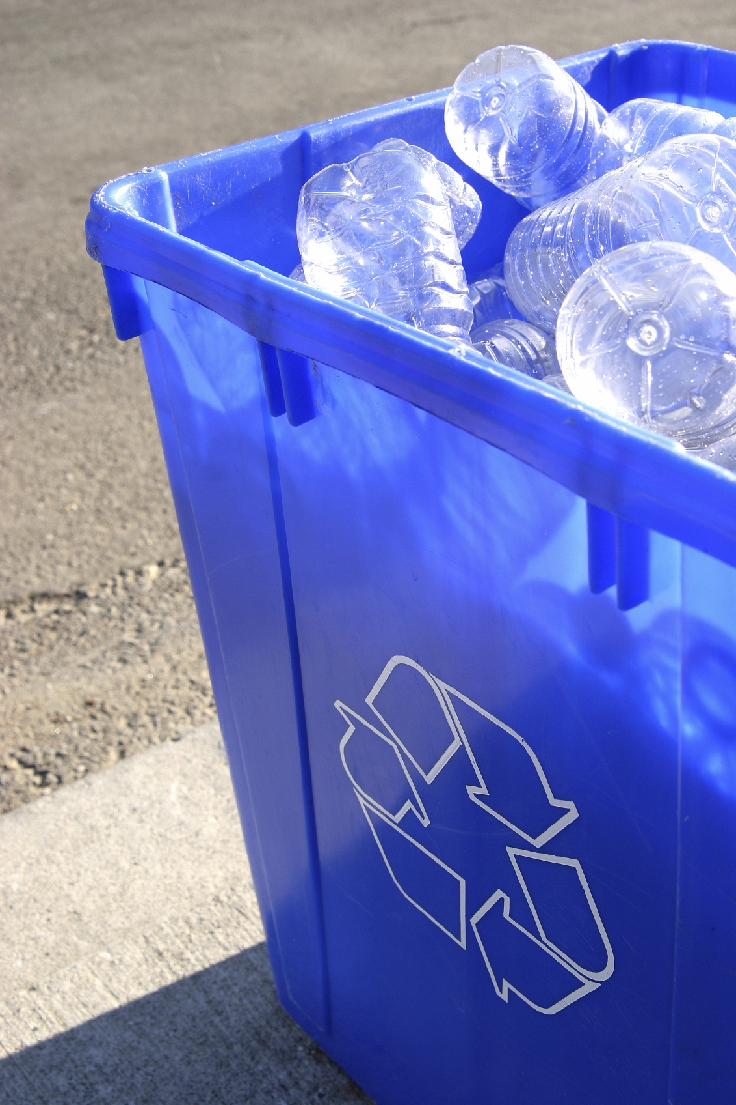
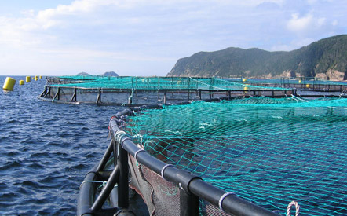

Discussion Topic 1:
Growing the Green Economy
Notes:
The green economy includes activities in all sectors, such as:
renewable energy sources
the design and construction of energy efficient buildings
environmentally sustainable agriculture, aquaculture and forestry
innovative clean technologies like ocean and ice observation systems
modern waste management systems
environmentally sustainable tourism opportunities
What does the green economy include?
Here are some examples of the opportunities and how can they lead to economic growth.
Clean energy development. As the majority of GHG emissions come from burning fossil fuels to generate energy, demand for clean, renewable energy sources will increase in Canada and abroad.
Technology development. As demand for cleaner products and services grows (such as electric vehicles, heat pumps, energy efficient equipment), there will be new markets for businesses and industries that develop and deploy clean technologies.
Job growth. Clean growth will create new jobs in sectors like distributed energy and the design and construction of greener buildings.
Energy efficiency. Improving energy efficiency can help tackle climate change while lowering energy bills for homeowners and improving businesses' competitiveness by lowering their operating costs. Businesses and industries that design, manufacture, sell and install energy efficient products and services, from building insulation products to energy efficient appliances and machinery will see increasing demand for their products and services.

Slide 15
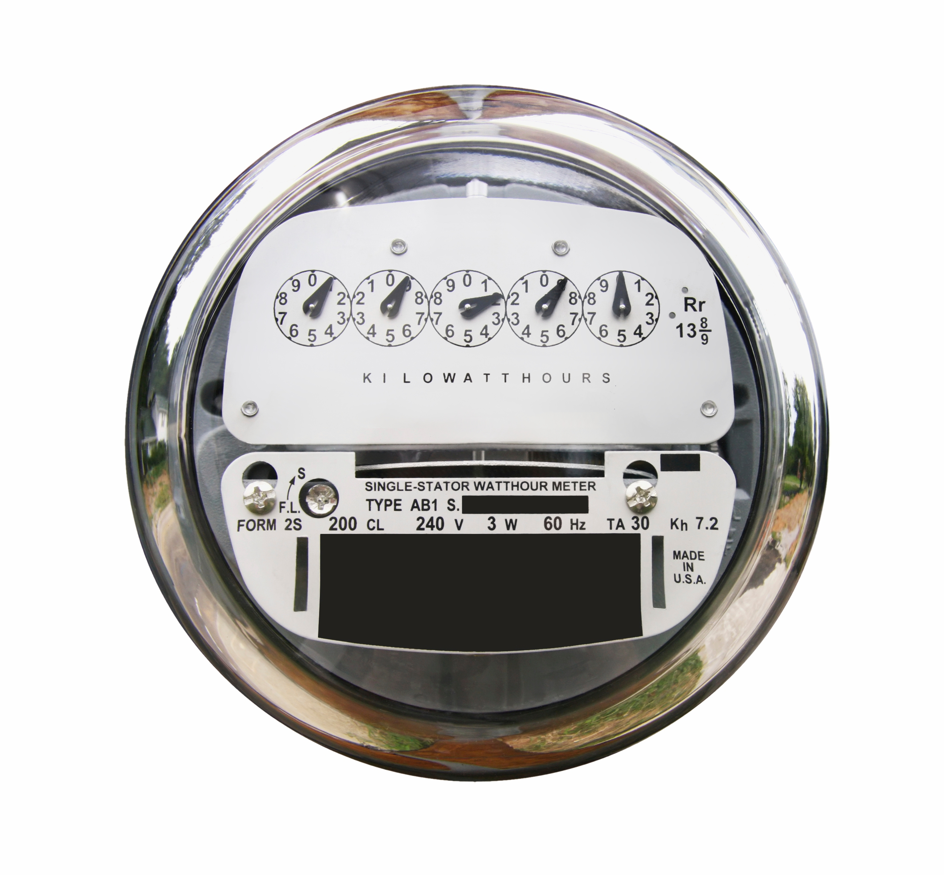
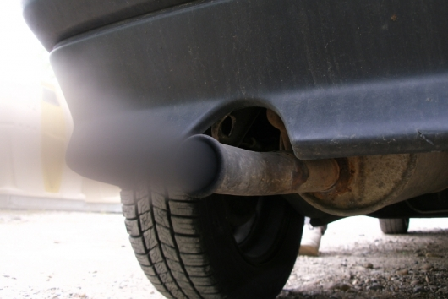

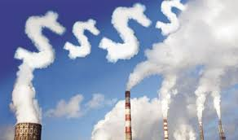
Discussion Topic 1:
Growing the Green Economy
90% of provincial GHG emissions
come from the consumption of
energy.
Two ways to reduce energy use and GHG emissions include:
  Increasing energy efficiency
  Carbon pricing
Notes:
Clean energy is a big part of the green economy.
About 90% of NL’s GHG emissions come from the consumption of energy, such as electricity generated at Holyrood and gasoline to power vehicles. Reducing greenhouse gas emissions associated with energy use through encouraging greater energy efficiency and greater use of clean energy sources, is important to addressing climate change.
There are two key ways that many governments are seeking to encourage this, namely:
Energy efficiency, and
Carbon pricing
Let’s take a closer look at both of these approaches.

Slide 16
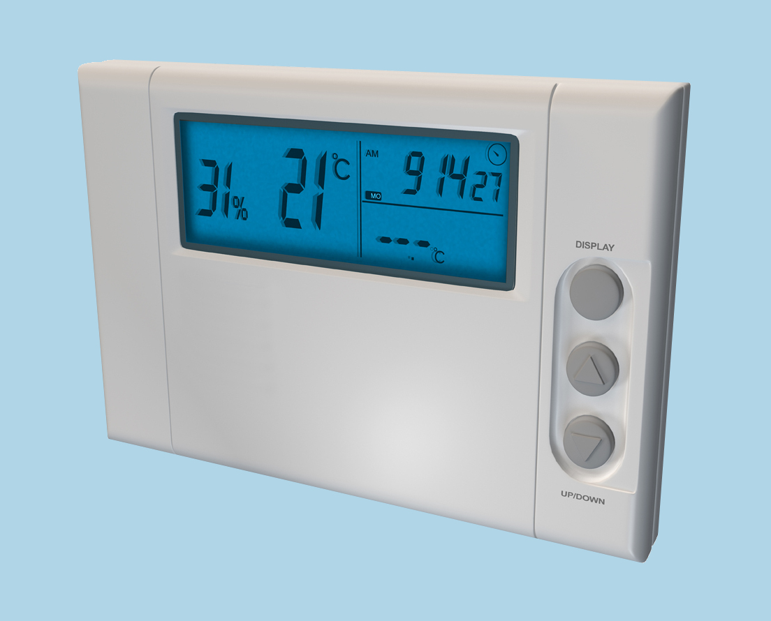
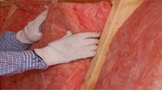
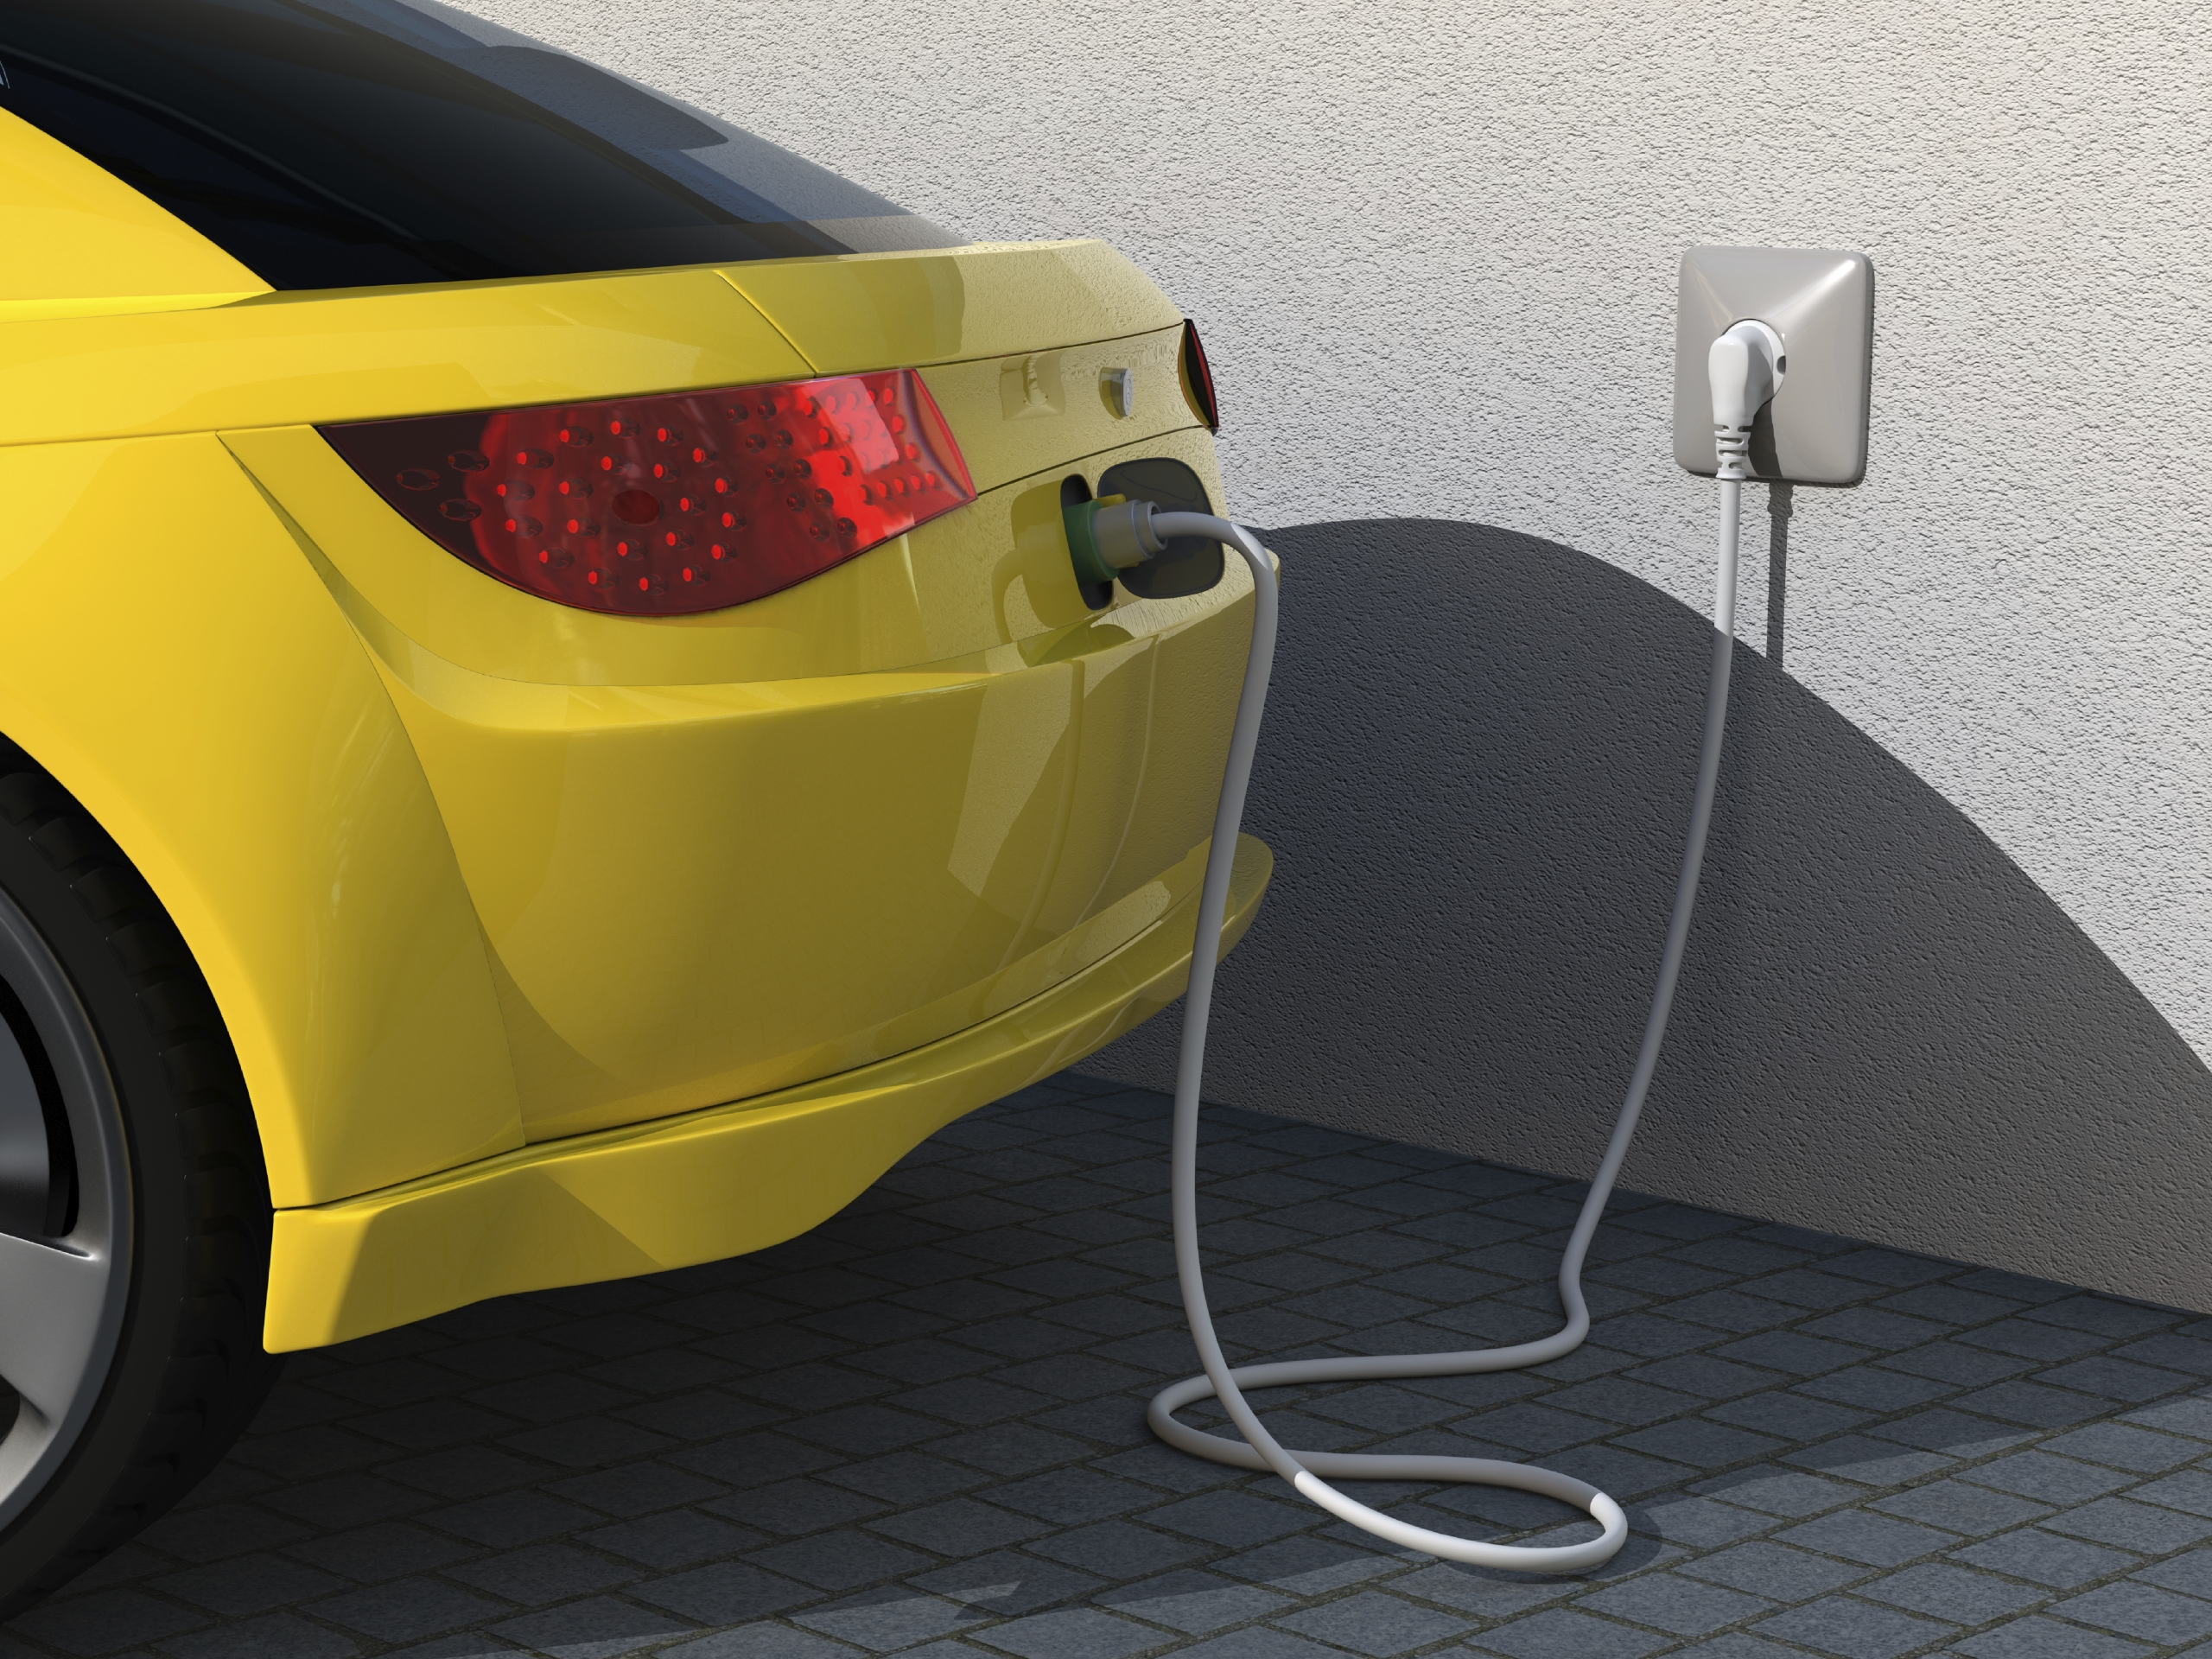



Discussion Topic 1:
Growing the Green Economy
Energy efficiency refers to using less energy to provide the same or better level of service
Behavioural Changes
Using New & Existing Technologies
Notes:
Energy efficiency can be a key part of taking action on climate change when it reduces the reliance on energy that is generated by burning fossil fuels. But it also has wider benefits, such as:
reducing household energy bills
enhancing business competitiveness
reducing local air contaminants
strengthening energy security
Energy efficiency is about using less energy to provide the same or better level of service. As shown on the slide, there are two components:
Energy conservation which seeks to alter the behaviour of individuals, companies and governments by encouraging them to reduce energy consumption. Conservation measures include switching off lights when leaving a room, turning off televisions or computers when not in use, or lowering thermostat settings at night.
Increasing the use of new and existing technologies. For example, a properly insulated home can be heated to the same level of comfort as an un-insulated home but uses a lot less energy. An energy efficient LED bulb provides the same amount of lighting, but uses less energy than an incandescent bulb.

Slide 17
Discussion Topic 1:
Growing the Green Economy
Carbon pricing often takes one of two forms:
  Carbon tax paid by consumers on fossil fuels, or
  Emissions limits that require companies to buy permits for each tonne of GHGs they emit.
Carbon pricing revenues are often used to lower other taxes, lower greenhouse gas emissions, and help grow the green economy.
Notes:
Now let’s consider carbon pricing. There are many ways to put a price on carbon, but two prominent approaches are a carbon tax and emissions trading. Both of these are already being used by other provinces to reduce GHG emissions and support growth in the green economy. Over 90 per cent of the Canadian population live in a province committed to carbon pricing.
The concept behind carbon pricing is straightforward. As GHG emissions cause damage that imposes a cost on society, a price is put on GHG emissions to discourage their release and to incentivize the use and development of lower carbon technologies and energy sources.
There are various forms of carbon pricing, such as a carbon tax or an emissions trading system.
Some jurisdictions ensure carbon pricing is cost neutral to companies and tax payers by recycling the revenue generated from carbon pricing to lower other income or corporate taxes, provide programs for low income households, or to help fund initiatives to tackle climate change such as programs to support energy efficiency and the installation of electric vehicle infrastructure.

Slide 18
Discussion Topic 1:
Growing the Green Economy
Discussion Question:
  What should the Government of Newfoundland and Labrador do to support clean economic growth?
Notes:
This is our first discussion question…so let’s hear your ideas.

Slide 19
Discussion Topic 2:
Adapting to Climate Change
The past is no longer predictive of the future. The climate will continue to change.
Adapting and planning for these changes is key
Information must be understood and used in order to be of benefit
Better Climate Change Information
Better Decision-Making
Stronger Communities
Better Planning
Notes:
Newfoundland and Labrador is a large, coastal province, so climate change-related impacts such as sea-level rise, costal erosion and storm surges from extreme weather events that are anticipated to become more frequent and intense can have significant impacts on coastal communities and their infrastructure, such as roads and bridges, as well as on residents’ properties.
Some climate change impacts are already “locked-in” and are unavoidable as a result of the GHGs already in the atmosphere, so planning and adapting to these unavoidable changes is key.
When it comes to planning for and adapting to climate change, having information is only the first step. This information needs to be understood and utilized by municipalities, community groups and organizations, and then incorporated into planning and other decisions to translate into reduced losses and stronger communities.

Slide 20
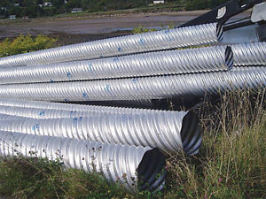
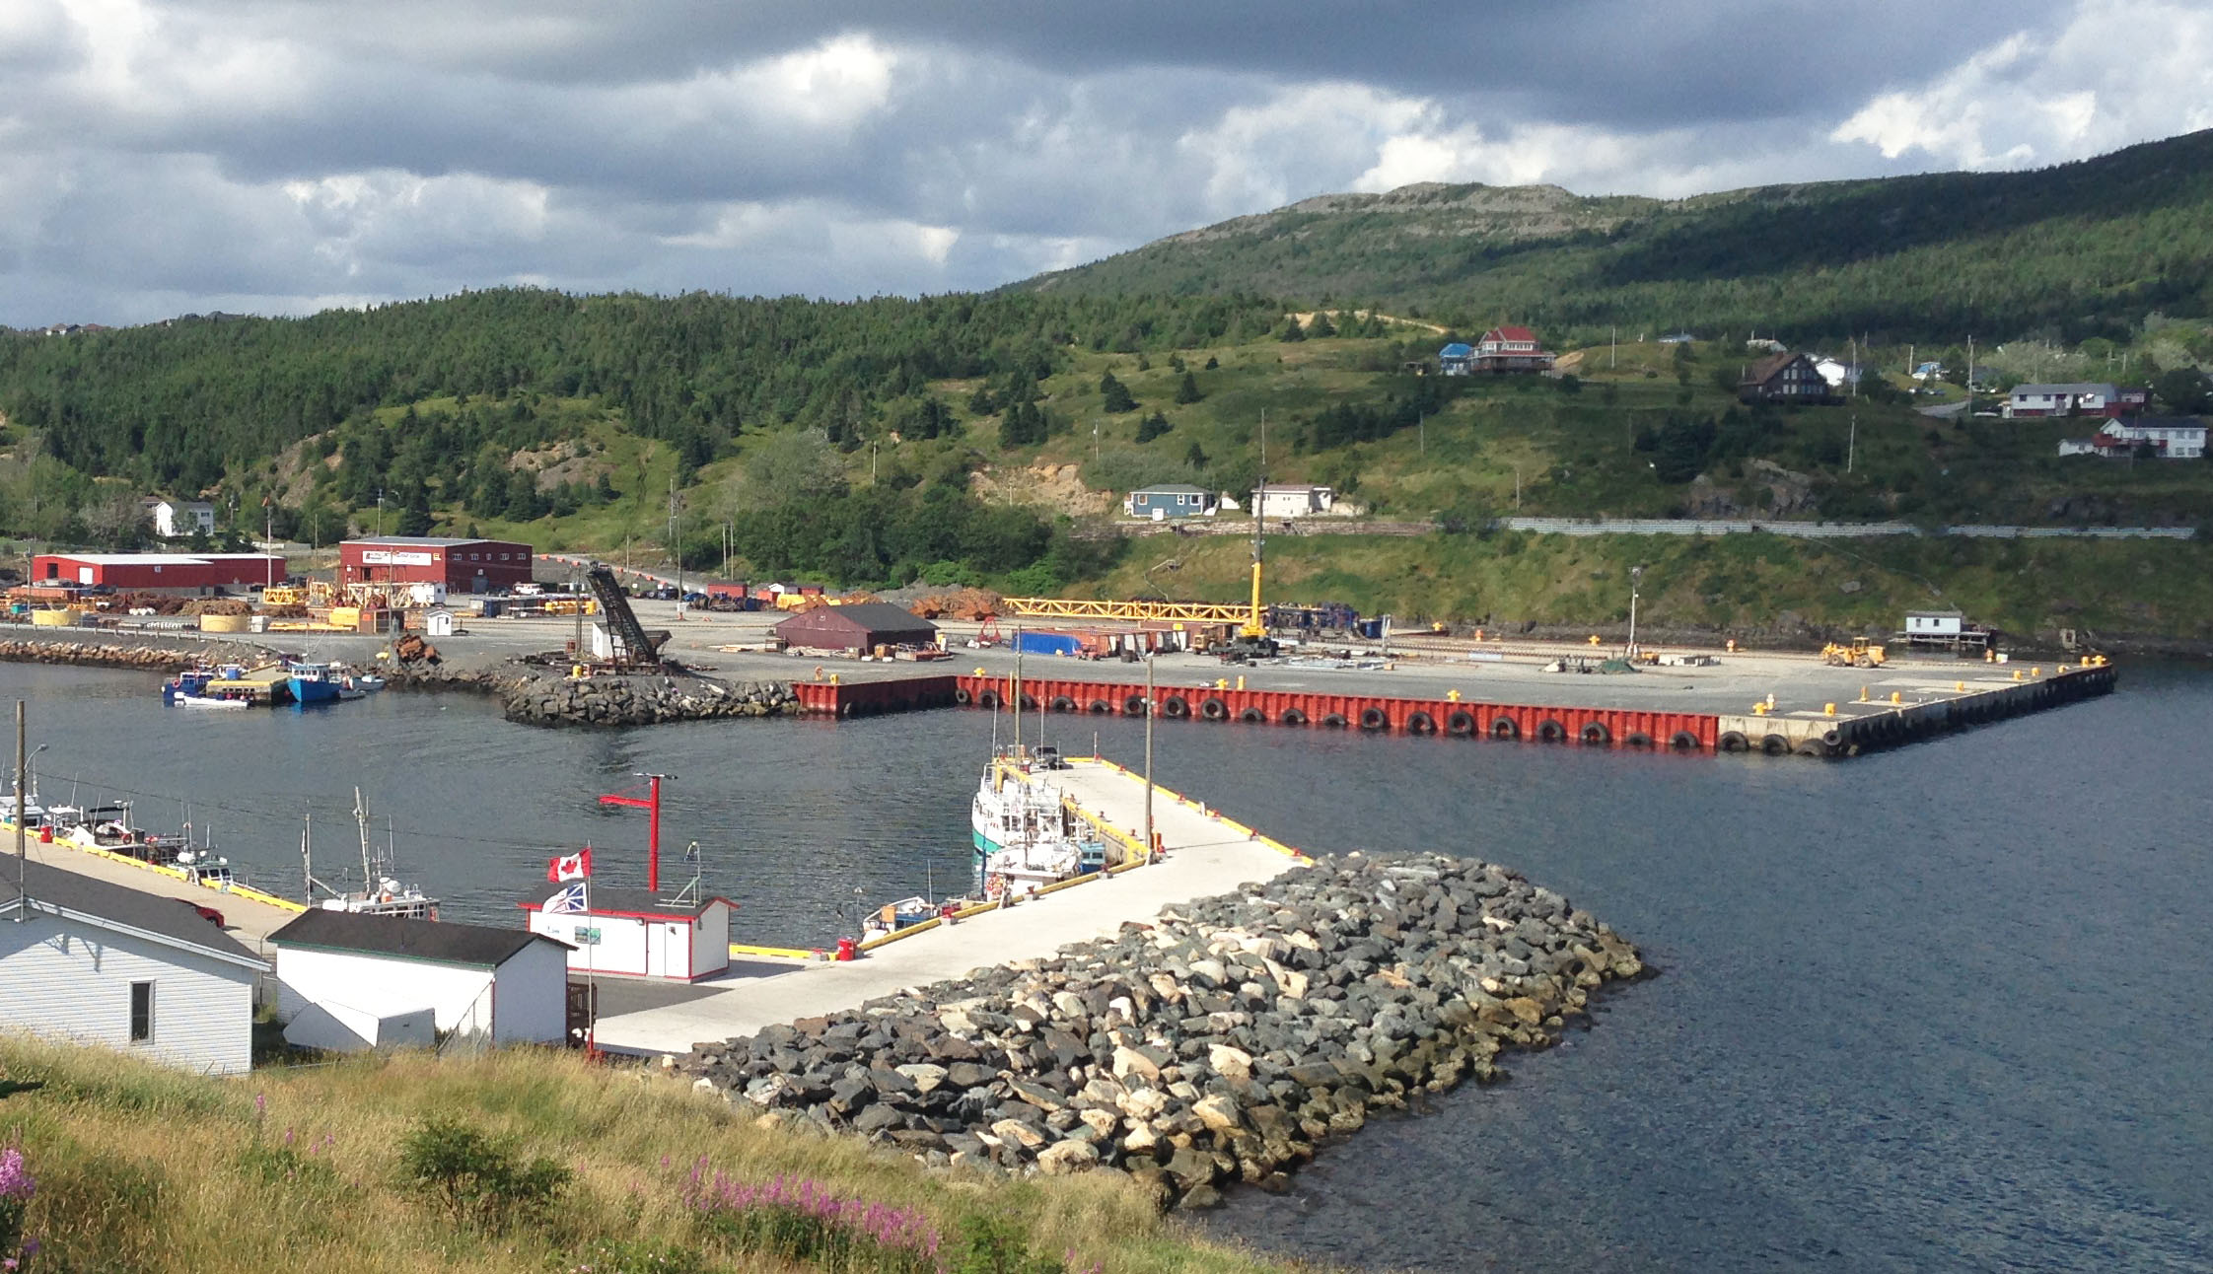
Discussion Topic 2:
Adapting to Climate Change
Adapting could include:
  Developing an emergency plan to prepare for flooding;
  Building infrastructure to withstand extreme weather; or
  Identifying opportunities of longer growing or summer tourism seasons
Government has developed tools to help adapt
Adapting can be straightforward
  Roads
  Wharves (e.g. Bay Bulls)
Notes:
As a result of GHG emissions that have accumulated in the atmosphere since the industrial revolution, the Earth is committed to a certain amount of warming and some impacts are now unavoidable.
Governments, communities, businesses and individuals need to understand, plan for and respond to these unavoidable changes in the climate. Adapting to climate change could include, for example:
new planning practices to avoid areas at risk of flooding or coastal erosion
ensuring infrastructure is built to the standards to withstand more extreme weather
identifying opportunities provided by longer growing or summer tourism seasons
Provincial Government has made progress, such as:
Worked with a climatologist at MUN to develop temperature and precipitation projections to mid-century
Updated flood risk maps to identify areas expected to be prone to flooding in the future
112 coastal erosion monitoring sites established to help understand how sea level rise and storm surges can affect community planning and development decisions
There are some great examples of adapting to climate change in the Province. For example:
When the Town of Bay Bulls rebuilt its wharf following Hurricane Igor, it considered the climate change projections. The Town built the wharf higher than it was before to withstand storm surges from extreme weather and rising sea-level.
Some engineers are using precipitation projections to make sure that culverts and other road infrastructure is designed to deal with water run-off expected from more intense storms.

Slide 21
Discussion Topic 2:
Adapting to Climate Change
Discussion Question:
  What steps do you think need to be taken to better adapt to climate change?
Notes:
And this brings us to our second discussion question…let’s throw out some ideas!

Slide 22
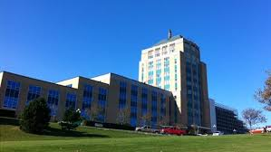
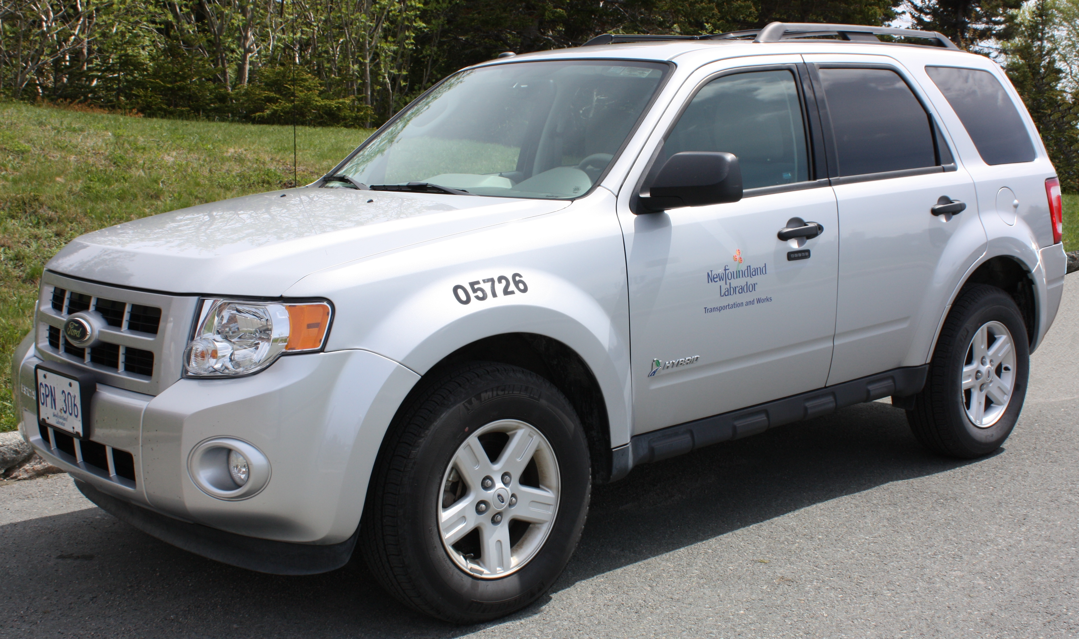
Discussion Topic 3:
Government Leadership
Governments can lead by example:
  in their own operations
  by adopting policies for others
The Provincial Government is a significant consumer of goods and services. It also:
  owns or leases hundreds of buildings;
  operates thousands of vehicles; and
  employs over 7,500 individuals.
Notes:
The Government of Newfoundland and Labrador has a role to play in tackling climate change. Governments can lead by example or can adopt policies for others to follow.
Government’s own operations are an opportunity to reduce energy use and GHG emissions. Core departments of the Provincial Government own or lease about 1,100 buildings, operate about 3,000 vehicles and employ over 7,500 individual throughout the province. The broader provincial public sector as a whole, including health authorities, educational institutions, and other entities, employs approximately 40,000 residents.
The Government of Newfoundland and Labrador is one of the largest consumers of goods and services in the province, at about $1 billion annually.
Given the size and scope of Government's operations, it can have a significant impact on the energy used and GHGs emitted from its own operations from things like:
Government buildings: they can be built to more stringent energy efficiency standards and be heated with more efficient systems like heat pumps and geothermal heat. Government adopted a Build Better Buildings policy that aims to ensure that buildings constructed with provincial funds are energy efficient and environmentally sustainable and responsible.
Government vehicles: Hybrid or electric vehicles can be incorporated into Government’s fleet reducing emissions and saving money. The Province has purchased hybrid vehicles like the one shown to help reduce its carbon footprint.
Government procurement: Government consumes more than $1 billion in goods and services each year, so prioritizing the purchase of energy efficient and low GHG-emitting products and services can save money and help fight climate change.

Slide 23
Discussion Topic 3:
Government Leadership
Governments can lead a shift in markets in the signals it sends:
  Regulations, codes, and standards
  Programs (e.g. rebates and incentives)
  GHG emission reduction targets
  Public awareness campaigns
These levers can support a transition in the economy toward more energy efficient and low-carbon products and services.
Notes:
Government can also support a transition toward a greener economy through some of the levers it has at its disposal, such as:
Legislation and regulation: for example, some provinces have regulation requiring the construction of energy efficient buildings in accordance with standards like the National Energy Code for Buildings;
Rebates and incentives to steer consumers toward the purchase of a range of energy efficient and lower-GHG-emitting products and services, such as building insulation products and electric vehicles. An example in this province is the Residential Energy Efficiency Program offered by the Newfoundland and Labrador Housing Corporation.
Newfoundland and Labrador has established a 2020 and 2050, but has not established a medium-term, 2030 target for GHG emissions reductions. Several other provinces and the federal government have adopted 2030 targets to provide a mid-point to take stock and assess progress towards longer term goals.
Government can send a strong signal by raising awareness. Activities could include providing information on the benefits of energy efficiency and practical advice on how individuals, businesses, or communities can help reduce and adapt to climate change in the course of everyday activities. The Government of NL launched the province’s first-ever public awareness campaign on climate change in 2012 with Turn Back the Tide.

Slide 24
Discussion Topic 3:
Government Leadership
Discussion Question:
  How should the Provincial Government demonstrate leadership on climate change?
Notes:
And now, our last discussion question…
How should Government demonstrate leadership on climate change in its own operations and help steer the private sector toward taking action?
Let’s come up with ideas for both areas:
How should Government demonstrate leadership on addressing climate change in its own operations, and
How can Government help steer the private sector, the broader economy and marketplace, toward taking action on climate change.

Slide 25
Concluding Question:
  Is there anything else you would like to add on the development of a climate change strategy for Newfoundland and Labrador?
Notes:
Before looking at next steps, I’d like to ask you if there is anything you would like to add on the development of a climate change strategy for the province which hasn’t been captured in the discussion?

Slide 26

What’s Next?
Consultations to conclude by September 16, 2016 and “What We Heard” document to be released
Provincial Climate Change Strategy in 2017
Keep up on the conversation at: www.gov.nl.ca/TalkClimateChange
Notes:
Thanks so much for coming out today!
The ideas and perspectives you shared today will be analyzed by the Office of Climate Change and Energy Efficiency and inform the Government of Newfoundland and Labrador as it develops a new climate change strategy for the Province.
Climate change affects us all and we must work together to make a difference.

Slide 27
Thank You!
Government entity responsible for consultations:
Office of Climate Change and Energy Efficiency
  Phone: (709) 729-1210
  Email: climatechange@gov.nl.ca
  Fax: (709) 729-1119
  Twitter: @CCEE_GovNL
www.gov.nl.ca/TalkClimateChange

