Slide 1
IM Orientation
OCIO Reference: DOC03880/2016 | Version: 2.0 | 2021-06-11
(Template and Example)
Providing direction on IM principles, concepts and compliance requirements.

Slide 2
Development Considerations
Note: The following slides contain sample content that does not represent a complete listing. Each organization should complete their own IM Legal and Regulatory Framework in order to properly identify all IM compliance requirements applicable to their organization and the individuals working on their behalf.

Slide 3
IM Orientation
Consider all of the items beneficial to directing and guiding an individual when joining, working in or leaving your organization:
New Hire
Current Employee
Employee Move (Inside Organization)
Employee Move (Outside Organization)

Slide 4
Resources
IM Legal and Regulatory Requirements
Industry Standards and Best Practices
Existing Education and Awareness Materials
PSAccess Courses (IM Category)
OCIO Website, other published materials, etc.
OCIO’s IM Policy Framework
MOIA, Rooms Act, ATIPPA, 2015, PHIA, Evidence Act, etc.
IM Compliance
Organization’s Internal IM Legal and Regulatory Framework
ISO Standards, Quality Control Practices, etc.
Consider all of the items that have an IM impact to your organization.
This could include:
Existing supports that can be leveraged/re-used to support standard concepts;
IM legal and regulatory concepts; and
Industry standards that may apply specific to the organization and its operations.

Slide 5
Sample Content
Note: The following slides contain sample content only and does not represent a complete listing. Each organization should complete their own IM Legal and Regulatory Framework in order to properly identify all IM compliance requirements applicable to their organization and the individuals working on their behalf.

Slide 6
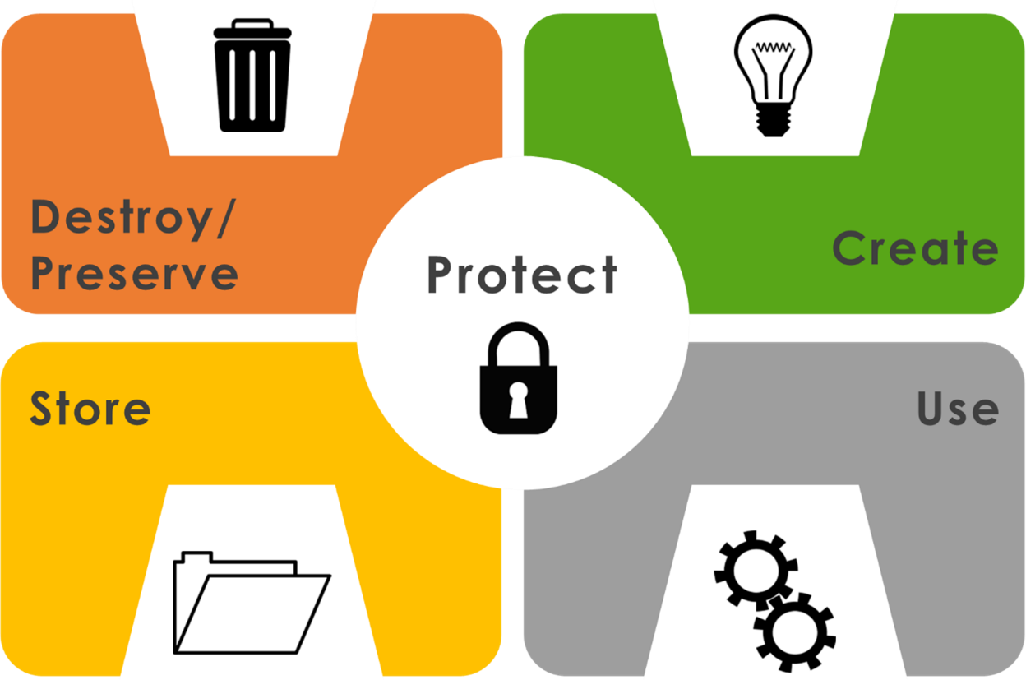
Information Lifecycle
The OCIO IM Framework provides guidance to cover the full information lifecycle from creation (through use and management) to disposition (through assessment, retention, destruction, deletion, transfer for permanent preservation).

Slide 7
IM Legal and Regulatory Framework
Legislation
Management of Information Act (MOIA)
Access to Information and Protection of Privacy Act, 2015 (ATTIPA, 2015)
Rooms Act
Electronic Commerce Act
Evidence Act
Transparency and Accountability Act
Financial Administration Act
Personal Health Information Act (PHIA)
etc.
Other Consideration
Other Federal/Provincial Legislation
GNL Policy Instruments (policy, directive, standard, procedure, etc.)
Contractual Requirements and Agreements

Slide 8
MOIA
Applies to (160+) Public Bodies including all departments and most other public bodies
Establishes the rules for Government Records and Information Management (IM):
all records created or received are property of the Crown
government records cannot be destroyed without authority (RRDS, CRIMS or Transitory Assessment)
offences for non compliance
Defines roles & responsibilities, in particular:
Head of a Public Body must develop, implement & maintain an IM Program
Treasury Board reviews standards, principles or procedures for adoption

Slide 9
ATIPPA, 2015
Describe the Access to Information and Protection of Privacy Act, 2015 and identify responsibilities.

Slide 10
Rooms Act
Describe the Rooms Act and identify responsibilities.

Slide 11
IM&P Policy
Describe the IM&P Policy
Describe the IM&P Principles

Slide 12
Directives
Instant Messaging
Transitory Records
Mobile Devices for Government Employees
Acceptable Use of the Government Network and/or Information Technology Assets
Use of Non-Government Email Accounts for Work Purposes
Add additional organizational-level materials

Slide 13
Standards
Corporate Records Information Management Standard (CRIMS)
Developing Records Retention and Disposal Schedules (RRDSs) for Operational Records
One Time Disposal (OTD)
Add any additional organizational standards including items such as naming convention, file locations and other standard operating materials.

Slide 14
Guidelines
Managing Transitory Records
Email Management
Discovery and Legal Hold
Managing Departmental Information through the Employment Cycle
Managing the Records of External Public Bodies
Add any additional organizational guidance materials

Slide 15
Specific to those responsible for IM Program
Corporate Records Information Management Standard (CRIMS)
Developing Records Retention and Disposal Schedules (RRDSs) for Operational Records
One Time Disposal (OTD)
Managing the Records of External Public Bodies
GuideBook – Guide to IM for Public Bodies (16 guidelines and supporting materials)

Slide 16
IM Concepts (Organization-level)
Highlight all organizational IM Program components.

Slide 17
Follow-up
Ensure to indicate where to find materials and who to reach out to for supports.
Set a time to check in with new staff.
Schedule regular refreshers for current staff.

