Slide 1


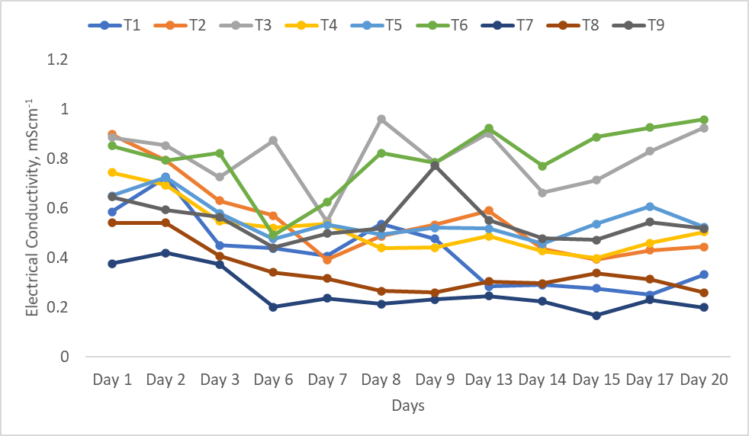
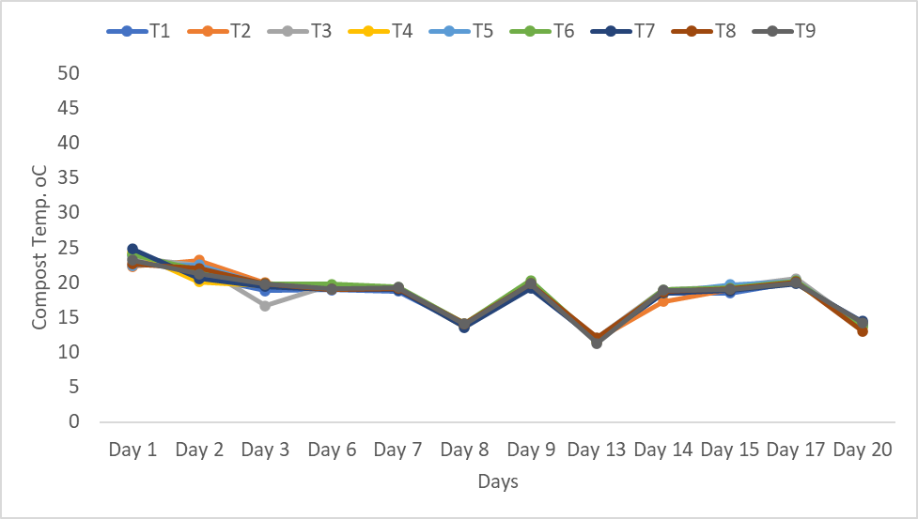
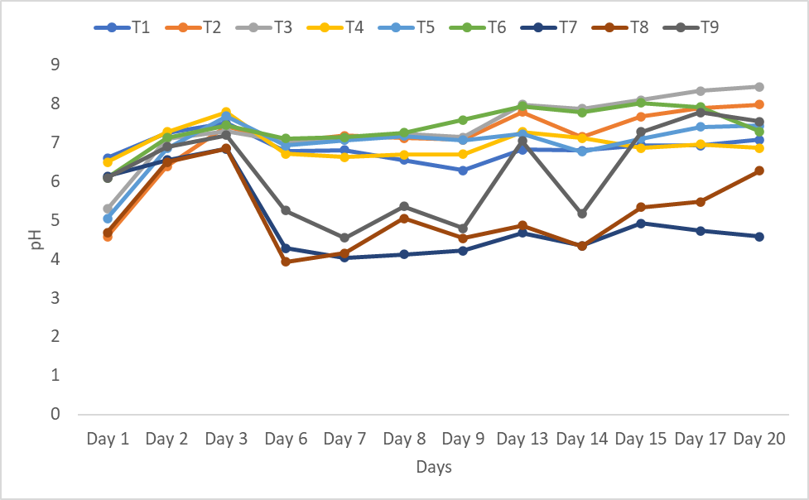
Sustainable production of engineered soils from local materials: A formulation, evaluation, and
repurposing of engineered soils. Dr. Adrian Unc^{1,2}; Dr. Amana Kedir^{1,2}; Jeremiah Vallotton (MSc)²
¹School of Science and the Environment, Memorial University of Newfoundland, Corner Brook, NL, Canada
²Environmental Science, Faculty of Science, Memorial University of Newfoundland, St. John's, NL, Canada
1. Background
3. Preliminary Results and Monitoring Data
The government of Newfoundland and Labrador agriculture policy “The way forward on agriculture”
Planned to increase local food production and diversify the economy by creating jobs opportunities.
Expand and diversify crop production, an avenue to also increase crop profitability.
Greenhouse producers are primarily importing potting soils from outside the province which affects the farm profitability and production sustainability.
Greenhouse crops require precise growth conditions, including high fertility soils
This province offers a wide variety of organic materials and peat resources
Table 1. Baseline characteristics of new and spent engineered soil.
Substrate base | n | pH | OM (%) | EC (mS/cm) | M3-P | M3-K | M3-Ca | M3-Al
 |  |  |  |  | (mg/L)
 |  | Mean (std) | Mean (std) | Mean (std) | Mean (std) | Mean (std) | Mean (std) | Mean (std)
Commercial soil (industry) | 1 | 6 | 60.2 | 14.2 | 134 | 338 | 1603 | 33
Commercial soil (local lab) | 1 | 6.1 | 37.9 | 10.8 | 124 | 220 | 1162 | nr
Spent soil substrate (spent soil, 70 days) | 1 | 6.7 | 24.3 | 21.8 | 586 | 1210 | 2756 | 17
Spent soil substrate (summer 2021) | 3 | 6.03 (0.46) | 32.33 (1.42) | 14.40 (4.25) | 101 (65) | 96 (18) | 1686 (521) | 2 (0)
Spent soil substrate (summer 2020) | 3 | 6.9 (0.26) | 33.27 (2.63) | 12.00 (1.61) | 90 (48) | 157 (58) | 1288 (179) | 19 (22)
Spent soil substrate (summer 2020, mixed with soil) | 3 | 5.97 (0.12) | 9.07 (1.01) | 18.93 (1.10) | 67 (2) | 151 (54) | 1233 (134) | 1488 (25)
Spent substrate (summer 2019) | 3 | 6.30 (0.30) | 19.23 (1.14) | 23.43 (2.27) | 283 (136) | 649 (18) | 2587 (223) | 284 (230)
Native soil (Histosol) | 3 | 4.47 (0.25) | 29.27 (6.60) | 19.47 (9.19) | 24 (22) | 20 (10) | 1289 (1648) | 1381 (472)
Native soil (Luvisol) | 3 | 5.60 (0.20) | 4.87 (0.40) | 13.07 (1.52) | 21 (24) | 54 (21) | 228 (105) | 1908 (173)
(c)
Conclusions
Engineered soil recipes such as organic waste, peat moss, and spent soil were identified for preparing feedstock.
Two types of worms (E. fetida and E. hortensis) were used in vermicomposting.
E. hortensis was very sensitive and did not able to adapt to new feedstock conditions.
E. fetida adapted to the new feedstock conditions and was able to produce a cast.
The system temperature was within the recommended range (0 to 35 ºC).
The pH, moisture, and conductivity vary by feedstocks and blocks.
Feedstock with the peat moss was more acidic than another feedstock.
Further optimization of the feedstock preparation and system condition will be conducted following the current experiment.
The feedstock with spent soil has favorable conditions for E. fetida.
Moisture control issues in treatments incorporating peat moss led to mite infestation.
This project aims to:
identify locally available recipes suitable to develop engineered soils including vermicompost.
characterize the physical and chemical properties of the recipes including soil-produced engineered soils and compost.
repurpose the depleted potting soils.
(a)
Material and Methods
Phase 1
Recipe identification and collection.
Baseline lab testing and procurement.
Feedstock preparation (grinding and 1:1 mixing)
Preliminary experiment
Phase 2
Fully replicated experiment: Three brown materials (peat moss, new and spent soil) mixed (1:1v/v) with green materials and two types of worm (E. fetida and E. hortensis)
Temperature, pH, moisture, and conductivity monitored.
[1] Government of NL, “Provincial Government Announces $13 Million for Plan to Develop Agriculture Sector and Create Jobs - News Releases,” 2020. [Online]. Available: https://www.gov.nl.ca/releases/2020/exec/0619n02/. [Accessed: 22-Oct-2020].
[2] Statistics Canada, “Unemployment rates of 25- to 29-year-olds, by educational attainment, Canada and provinces,” 2019. [Online]. Available: https://www150.statcan.gc.ca/t1/tbl1/en/tv.action?pid=1410036201. [Accessed: 22-Oct-2020].
[3] L. Butler et al., “Organic Waste in Newfoundland: A Review of Available Agriculture, Fishery, Forestry and Municipal Waste Literature,” St. John’s, Newfoundland and Labrador, 2017.
[4] Government of Newfoundland and Labrador, “The mineral industry in Newfoundland and Labrador: Its development and economic contributions,” 2004.
(b)
Figure 1. Vermicompost monitoring data (average, n=5): (a) system temperature, (b) pH, and (c) electrical conductivity.
Key: Green material mixed at 1:1 (v/v) with new potting soil (T1),
new potting soil with E. fetida (T2), new potting soil with E. hortensis (T3), spent potting soil (T4); spent potting soil with E. fetida (T5), spent potting soil with E. hortensis (T6), peat moss (T7), peat moss with E. fetida (T8), and peat moss with E. hortensis (T9).

