Slide 2



1.0 Introduction
Co-op Development is a group process which involves:
Confirming the collective need for a service
Learning about the co-op business model
Accessing co-op development services
Developing by-laws and a business plan
Complying with co-op legislation
Accessing ongoing operational advice and support

Slide 3

2.0 Identifying a Co-op Development Opportunity
Is the need for a service the primary motivation?
Will there be a benefit for members that will justify their investment?
Will members be willing to pay for the services the co-op will provide?
Is there community and/or industry sector support?

Slide 4
2.0 Identifying a Co-op Development Opportunity
Is there enough interest to form a steering committee to lead the development process?
Is there enough potential for financial sustainability?
Is there an understanding of the steps involved in the process?

Slide 5
3.0 Steps in Building the Co-op Enterprise
3.1 The co-op steering committee
3.2 Developing the co-op concept paper
3.3 Co-op education and group development
3.4 Developing the co-op by-laws
3.5 Member recruitment and communications
3.6 Developing the business plan

Slide 6
3.0 Steps in Building the Co-op Enterprise
3.1 The Co-op Steering Committee
Made up of individuals committed to leading the establishment of the new co-op
Role of the committee is to coordinate/implement the steps involved in the development process
Committee members share the work involved and meet regularly to address issues as they arise
A chair is usually selected and the committee represents the interests of the co-op during the development process
Usually remains in place until the first board of directors is elected after the co-op is incorporated

Slide 7
3.0 Steps in Building the Co-op Enterprise
3.2 Developing the Co-op Concept Paper
Provides a description of the co-op objectives, member services to be provided and benefits to the community
Should also identify membership criteria and equity investment requirements
Should reflect the consensus of steering committee members to ensure a common understanding of goals and expectations
Is updated as the development process proceeds and decisions are made by the steering committee (Worksheet #1)
Is a communications tool that helps ensure consistent messaging throughout the development process

Slide 8
3.0 Steps in Building the Co-op Enterprise
3.3 Co-op Education and Group Development
A knowledge of the co-op business structure is important in deciding if it is the appropriate business development option
An awareness of the steps involved will ensure that the steering committee understands its role in the co-op development process
An understanding of the co-op principles and values is also an important aspect of co-op development and ongoing operations
Understanding meeting management and democratic governance is key to member engagement and the decision making process
Presentations/workshops are available to assist the steering committee in addressing these and other education requirements

Slide 9
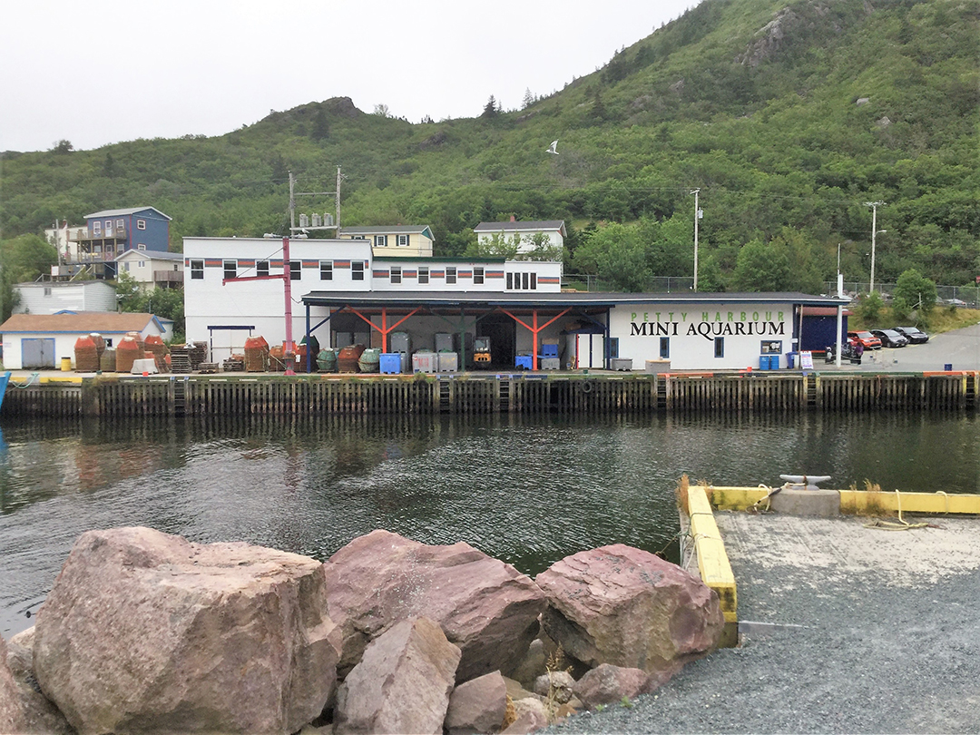
3.0 Steps in Building the Co-op Enterprise
3.4 Developing the Co-op By-Laws
All co-ops are required to develop a set of by-laws to govern their operations
They are developed by c. the steering committee in consultation with other future co-op members

Slide 10
3.0 Steps in Building the Co-op Enterprise
3.4 Developing the Co-op By-Laws
They must comply with co-op legislation and are a mandatory requirement for incorporation
Adapting existing by-laws from similar co-ops operating in other jurisdiction can assist with the process
Some by-law sections are unique to each co-op and require project specific consideration (Worksheet #2)

Slide 11

3.0 Steps in Building the Co-op Enterprise
3.5 Member Recruitment and Communications
Ongoing communications with potential members will ensure informed decision making
The concept paper can be a key communications tool in the member recruitment process

Slide 12
3.0 Steps in Building the Co-op Enterprise
3.5 Member Recruitment and Communications
Recruitment of additional members for larger co-oops can be addressed through public meetings and social media tools
Smaller meetings and individual contacts may be appropriate for smaller co-ops
Member commitment can be confirmed by the purchase of an initial share, held in trust until the incorporation process is completed

Slide 13
3.0 Steps in Building the Co-op Enterprise
3.6 Developing the Business Plan
Submission of a business plan is a requirement for incorporation
It should provide a description of how the new co-op will operate and what services it will provide for its members
It should address operational costs and sources of revenue and demonstrate potential for long term self-sustainability
May be simple or more detailed, depending on the size and complexity of the proposed new co-op
Each co-op’s plan will reflect its own approach to delivering services for its members

Slide 14
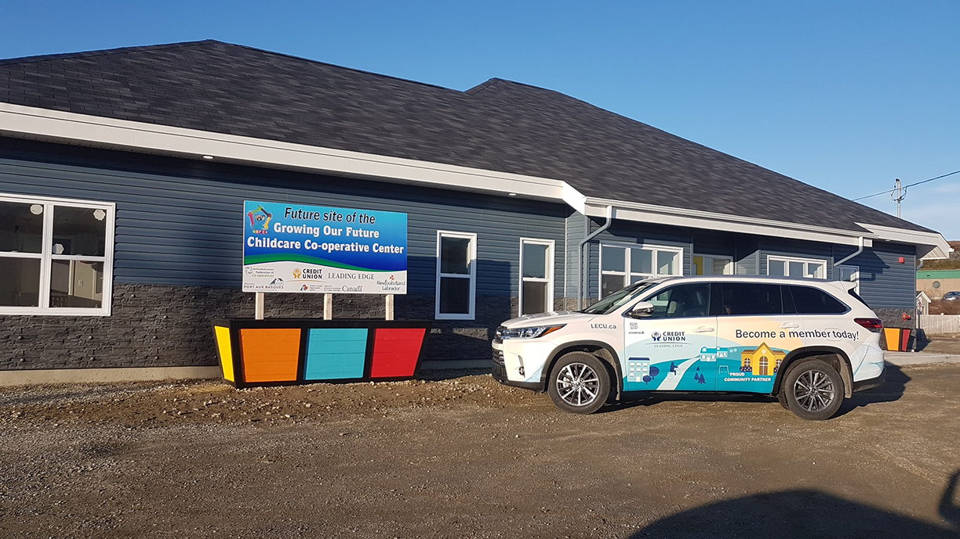
4.0 Incorporation and Business Start-Up
4.1 Applying for Incorporation
4.2 Commencement of Business
4.3 Ongoing Operations

Slide 15
4.0 Incorporation and Business Start-Up
4.1 Applying for Incorporation
Hold a membership meeting to approve proceeding with the application
Complete articles of incorporation and submit to the Registrar of Co-ops along with:
  The draft co-op by-laws
  The co-op business plan
  The incorporation fee ($250)
Approval of the application gives co-ops legal status as incorporated, limited liability business in the province

Slide 16
4.0 Incorporation and Business Start-Up
4.2 Commencement of Business*
Confirm the co-op’s provisional board of directors
Ensure banking, accounting and admin. structures are in place
Implement business financing and credit arrangements
Address equipment, facilities and staff requirements (if any)
Maintain member communications and public awareness activities
Hold first annual general membership meeting and elect the board of directors
*Does not have to take place immediately following incorporation

Slide 17
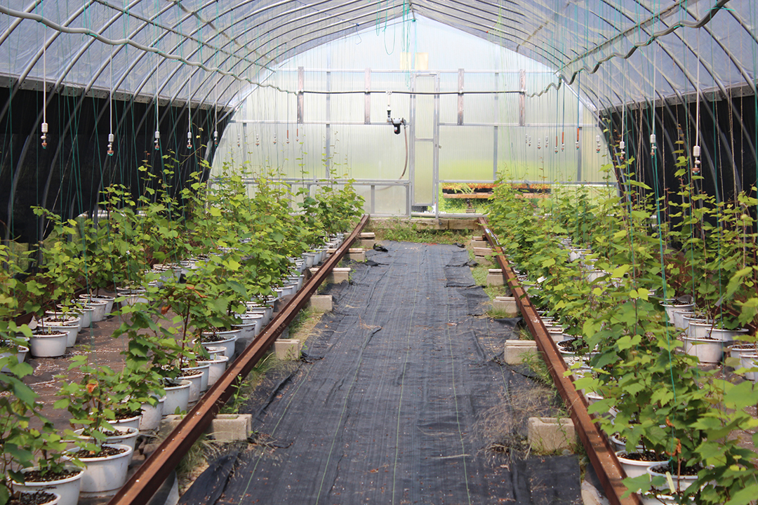
4.0 Incorporation and Business Start-Up
4.3 Ongoing Operations
Ensure a well-functioning board of directors that meets regularly
Initiate operational policies and procedures as required
Monitor and update the co-op’s business plan

Slide 18
4.0 Incorporation and Business Start-Up
4.3 Ongoing Operations
Maintain effective communications with the membership
Build business partnerships and support networks
Maintain a focus on co-op education and leadership development
Engage in strategic planning to address long-term viability
Maintain linkages with the broader co-op business sector

Slide 19
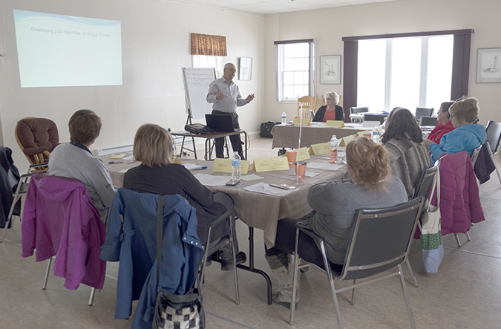
5.0 General Considerations
Ensure everyone has an “up front” understanding of the steps involved in the co-op development process

Slide 20
5.0 General Considerations
Maintain an ongoing awareness of the importance of the co-op principles and values
Learning and skills development should be an ongoing process for all involved
Partnerships and resource networks are critical to long term success

Slide 21
Worksheet #1 – Co-op Development Concept Paper
1. Confirming the Need
What is rationale for proceeding with the formation of a co-op?
2. Services to be Provided
What specific services will the co-op provide for its members?
3. Member and Community Benefits
Will other benefits be provided for the community/industry sector?
4. Membership Eligibility
Who will be the member/owners and investors in the co-op?

Slide 22
Worksheet #1: Co-op Development Concept Paper
5. Operational Structure
Will the co-op return profits to its members or be not-for-profit?
6. Comparison with Other Business Structures
How will the co-op differ from non-profit industry and/or social organizations?
7. Existing/Potential Partners
What other agencies will assist with development of the co-op?
8. Facilities and Location
What facilities/equipment, etc., are required and at what location?

Slide 23
Worksheet #1: Co-op Development Concept Paper
9. Operational Costs
Is there a general estimate of start-up and operational costs?
10. Member Shares and Financing
How many members are anticipated and what will be their investment requirements?
11. Time Lines
Is timing an important consideration for the development process?
12. Other Key Issues to be Resolved
Are their critical issues or obstacles that need to be addressed?

Slide 24
Worksheet #2: Co-op By-Laws
Name, address, and/or business Location
Objectives and member services to be provided
Member share capital required and service fees (if any)
Membership eligibility and the application process
Board and executive structure
Board powers and responsibilities
Provision for annual and special meetings
Distribution of financial surplus (profits)
Financial reporting requirements and disclosure

Slide 25
Questions/Comments?
Thank you!
Contact Information

