Slide 2



1.0 The Co-operative Business Model
A co-operative:
is a legally incorporated, limited liability business that can operate in any business sector
is owned by its members who purchase shares in the co-op and use its services
must generate revenue from service delivery to pay operating costs
can access business loans, sign contracts and hire staff
can distribute profits back to co-op members
can retain profits for future operational needs

Slide 3
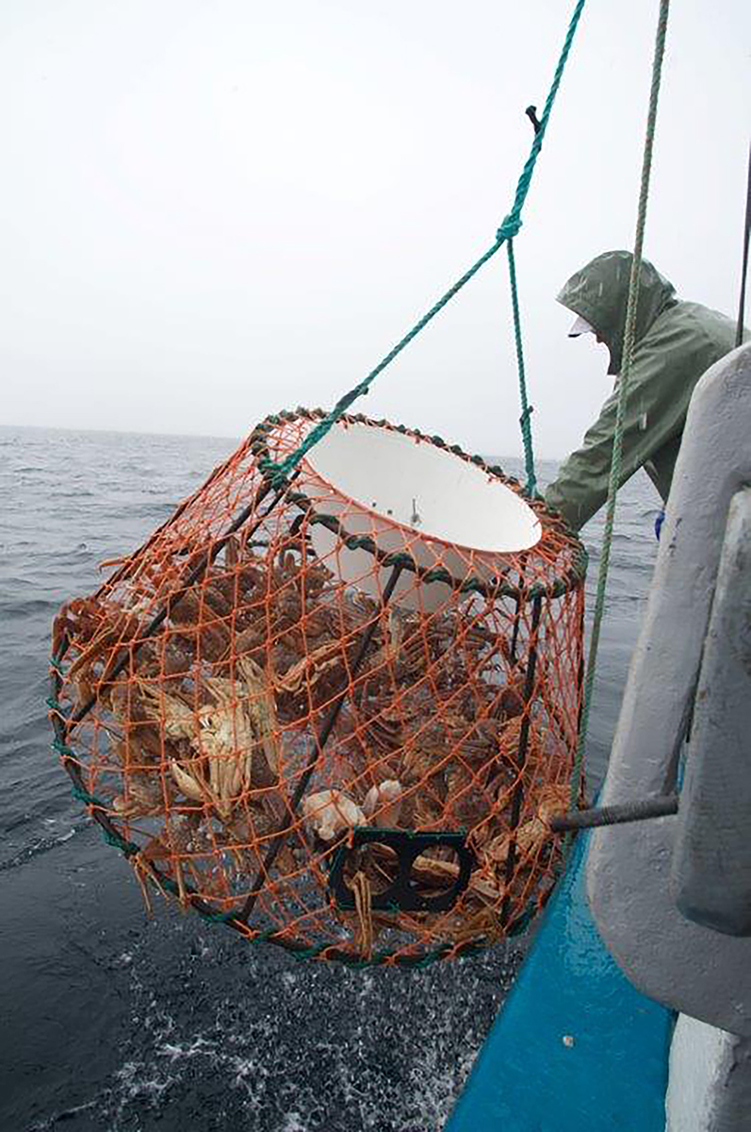
1.0 The Co-operative Business Model
1.1 Co-operative Definitions
International Co-op Alliance
  “An autonomous association of persons united voluntarily to meet their economic, social, and cultural needs and aspirations through a jointly-owned and democratically-controlled enterprise.”

Slide 4

1.0 The Co-operative Business Model
1.1 Co-operative Definitions
Co-ops Mutuals Canada
  “A co-op is an enterprise that is jointly owned by its members who use its services. All members are equal decision makers in the enterprise (one-member, one-vote) and share the benefits, based on how much they use the co-op’s service.”

Slide 5
1.0 The Co-operative Business Model
1.1 What is a Co-operative?
Locally owned and controlled by its members/owners
Democratic governance - one member/one vote
  - Not based on number of shares held
Member’s primary benefit is quality services
  - Not financial return on investment
Profit is secondary but is a business goal
  - Rebated based on member use of services
  - Not based on share value
Can also be non-profit/social enterprises

Slide 6
1.0 The Co-operative Business Model
1.2 Some Types of Co-operatives
Community service (non-profit): provide child care, health, housing and other social services
Consumer: provide goods/services for members
Producer: owned by fishers, farmers, artisans, etc.
Worker: owned by the employees
Credit unions: provide financial/banking services for members
Multi-stakeholder: different categories of membership

Slide 7
1.0 The Co-operative Business Model
1.3 Comparison with Other Business Models
Public Sector: governments that provide public services funded by taxpayers
Private Sector: businesses that provide services to maximize profits for shareholders
Co-op Sector: businesses that put member service needs and community sustainability before profit

Slide 8

1.0 The Co-operative Business Model
1.4 Misperceptions about Co-operatives
Co-ops have a high failure rate
- They have a much higher survival rate than private sector enterprises
Co-ops are charitable organizations
  - They are businesses that can share their profits with their members
Co-ops just sell groceries
  - They actually operate in many business sectors
Co-ops are irrelevant in a global economy
  Globally, there are over 800 million co-ops, employing over 100 million people

Slide 9
2.0 The Provincial Co-op Sector
2.1 Local Co-ops and Credit Unions
  9 credit unions (Atlantic Central)
  8 consumer
  6 agricultural
  4 fisheries
  3 child care
  2 community development
  20 housing (Co-op Housing Association NL)
  30 other

Slide 10
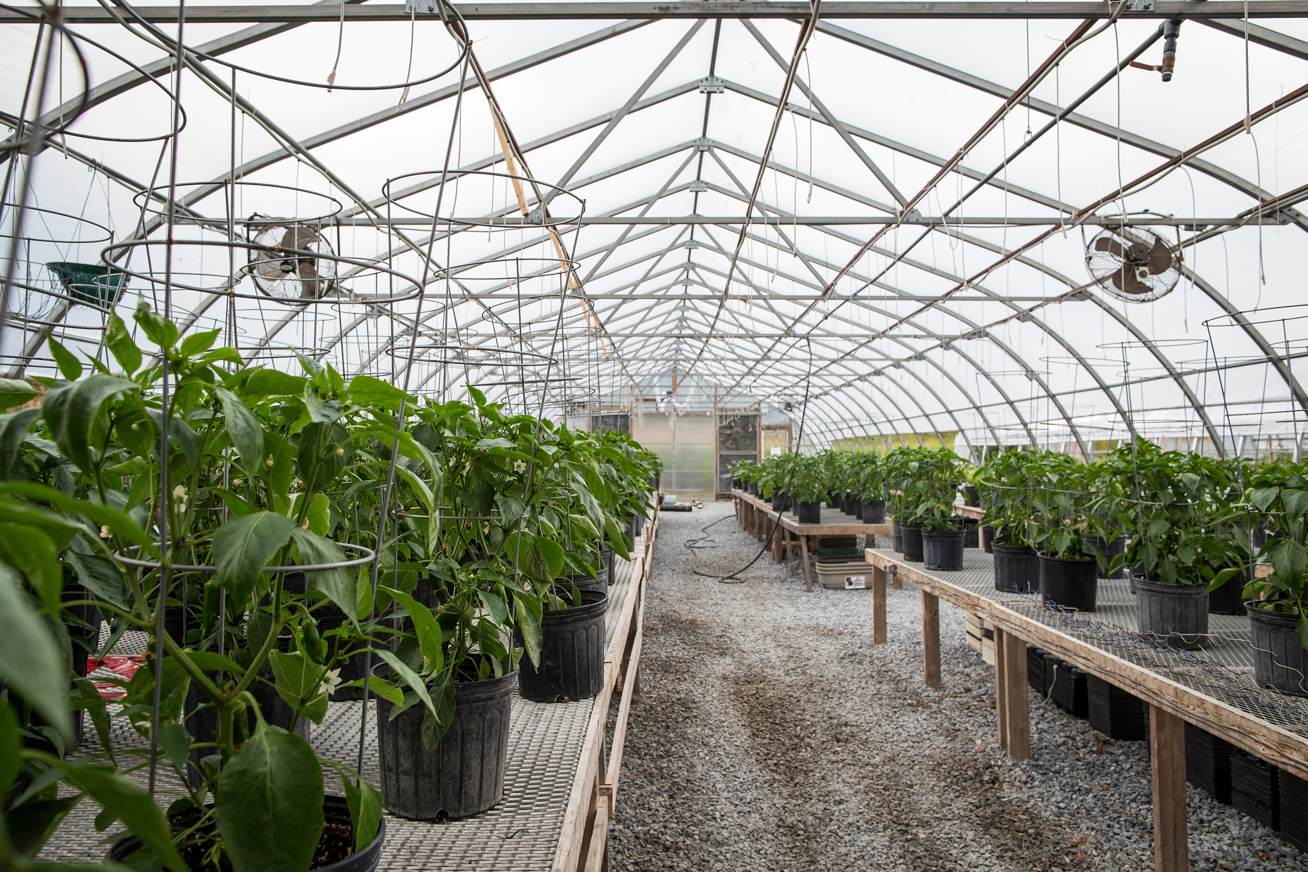
2.0 The Provincial Co-op Sector
2.2 National Co-ops in Newfoundland and Labrador
  The Co-operators - Insurance/Investment
  Agropur Co-op - Dairy
  Mountain Equipment Co-op
  True Serve - Building Supplies
  Desjardin - Financial Services
  Scotian Gold - Agriculture
  Ocean Spray/Sunkist - Agriculture

Slide 11
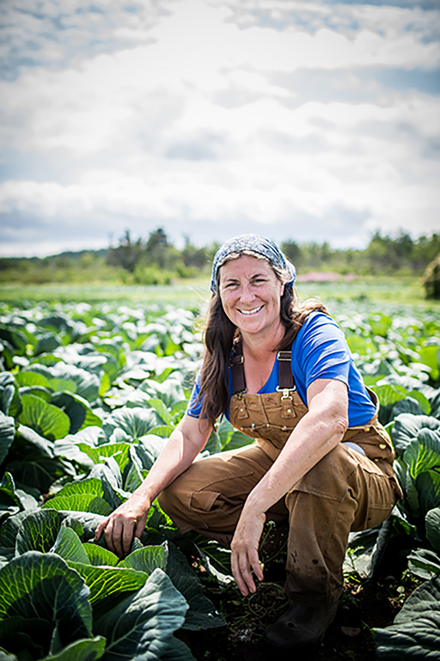
2.0 The Provincial Co-op Sector
2.3 Sector Support Networks
  NL Federation of Co-operatives
  Co-op Housing Association of NL
  Atlantic Credit Union Central
  Atlantic Retail Co-op Federation
  Co-ops Mutuals Canada
  Co-op Housing Federation of Canada
  International Co-op Alliance
  Co-op Zone Developer’s Co-op

Slide 12
2.0 The Provincial Co-op Sector
2.4 Government Support Agencies
  Service NL (Provincial)
  Credit Union Deposit Guarantee Corporation (Provincial)
  Tourism, Culture, Industry and Innovation (Provincial)
  Industry, Science and Economic Development (Federal)
  Atlantic Canada Opportunities Agency (Federal)

Slide 13
3.0 The National and Global Co-op Sector
3.1 The Canadian Sector
  Over 8,000 co-ops in Canada
  21 million members
  Provide employment for over 600,000 people
  Total income exceeds $3.3 billion annually
  Over 300 new co-ops are established in Canada each year
    - Organic food producers
    - Car sharing
    - Funeral
    - Wind energy/bio fuels
    - Social enterprises

Slide 14
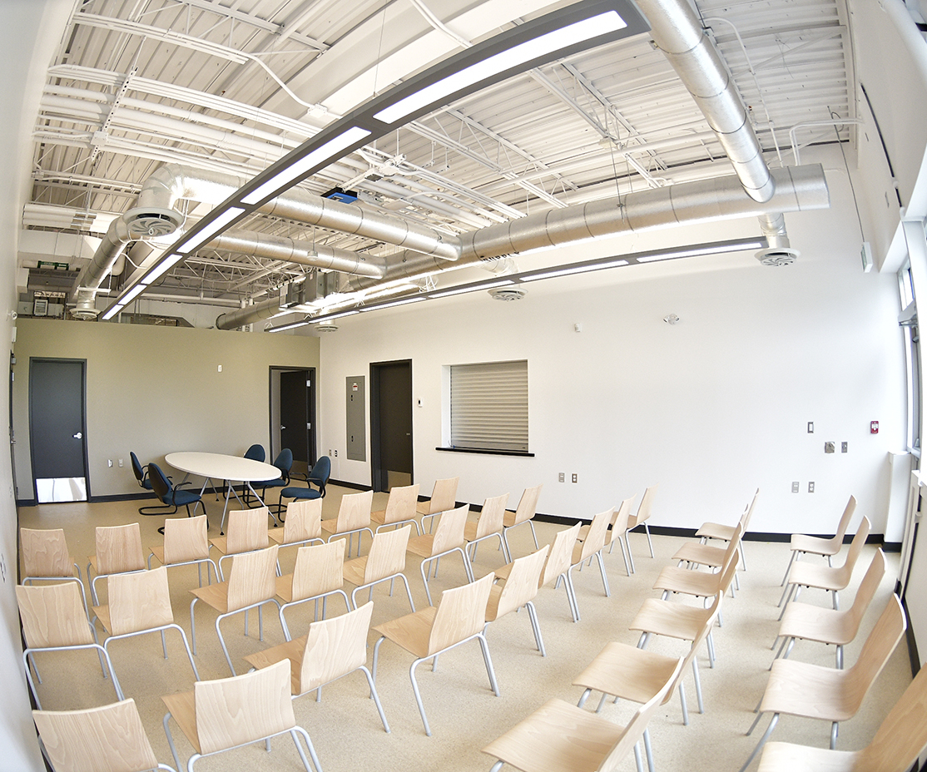
3.0 The National and Global Co-op Sector
3.2 The Global Co-op Sector
  Over 800 million people in 100 countries are co-op members and they provide over 100 million jobs globally

Slide 15
3.0 The National and Global Co-op Sector
3.2 The Global Co-op Sector
  In the USA, 30,000 co-ops employ over 2 million people
  There are 7,000 co-ops in the U.K. owned by 15 million members
  In Italy, there are over 70,000 co-ops employing 1 million people
  There are 68,000 credit unions operating in 109 countries on six continents

Slide 16

4.0 Co-op Business Structure and Management
4.1 Member/Owner Responsibilities
  Attend the AGM and other membership meetings
  Invest share capital as stated in the by-laws
  Use the services of the co-op
  Participate in board elections
  Be aware of and abide by the by-laws
  Serve on committees
  Promote the co-op to others

Slide 17
4.0 Co-op Business Structure and Management
4.2 Member Benefits
  Access to quality goods and services at minimum cost
  Democratic control of the decision-making process
  Opportunity to share in profits or re-invest them in the community
  Enhanced engagement in the community development process
  Knowledge building and leadership development
  Greater control over delivery of community services

Slide 18
4.0 Co-op Business Structure and Management
4.3 Board of Directors Responsibilities
  Articulate the co-op’s mission, purpose and policies
  Maintain financial management procedures
  Select, supervise and evaluate management
  Ensure ongoing member/public communications
  Organize the AGM and report to members
  Participate in board training sessions
  Manage the member application process
  Participate in board and membership meetings
  Represent the co-op at community events

Slide 19
4.0 Co-op Business Structure and Management
4.4 Committees
  Standing committees address ongoing activities and include:
    The executive committee which usually consists of the president, vice-president, secretary and/or treasurer
    Others may include co-op education, finance/audit, member communications, marketing and promotion, etc.
  Working committees are temporary and may be created to address specific issues that may arise from time to time.

Slide 20
4.0 Co-op Business Structure and Management
4.5 Management and Staff
  In larger co-ops the board of directors may hire a manager who:
  Is responsible for delivery of co-op services as directed by the board
  Hires and supervises staff and oversees day-to-day co-op operations
  Must comply with co-op by-laws, policies and board directives
  Reports to the board of directors and ultimately to the membership re: operation of the business

Slide 21

4.0 Co-op Business Structure and Management
4.6 Smaller Co-operatives
  Often do not require a manager or full-time staff for administration or service delivery

Slide 22
4.0 Co-op Business Structure and Management
4.6 Smaller Co-operatives
  Much of the work is undertaken by the members to minimize cost of operations
  May engage part-time or seasonal staff as required
  Often owned by members who are small business owners who absorb costs of co-op operations

Slide 23
5.0 Co-op Principles, Legislation and Governance
5.1 Co-op Values and Principles
These principles guide the operations of all co-op enterprises:
  Voluntary and Open Membership
  Democratic Member Control
  Member Economic Participation
  Autonomy and Independence
  Education, Training, and Information
  Co-operation Among Co-operatives
  Concern for Community

Slide 24

5.0 Co-op Principles, Legislation and Governance
5.2 Legislation
  Co-ops are limited liability businesses incorporated under provincial or federal co-op/credit union legislation

Slide 25
5.0 Co-op Principles, Legislation and Governance
5.2 Legislation
  The framework which governs their structure, governance and operational requirements includes:
    - Incorporation procedures
    - Responsibilities of members
    - Powers of the board of directors
    - Meeting and financial reporting requirements
    - Procedures for dissolution

Slide 26
5.0 Co-op Principles, Legislation and Governance
5.3 Co-op By-Laws
  Co-op by-laws are required for each co-op/credit union and often include:
  Objectives of the co-op and services provided
  Requirements for membership, rights and responsibilities

Slide 27
5.0 Co-op Principles, Legislation and Governance
5.3 Co-op By-Laws
  Procedures for member and board of directors meetings
  Member share purchase requirements
  Allocation of surplus profits and borrowing powers
  They are unique to each co-op/credit union and must be approved by the membership

Slide 28
5.0 Co-op Principles, Legislation and Governance
5.4 Operational Policies
  These build on the by-laws by outlining procedures to address such issues as:
  Personnel policies and working conditions
  Member communications/complaints
  Conflict of interest
  Financial management and accounting
  Charitable donations and public relations
  Policies are unique for each co-op and may be adopted and amended as necessary to address operational needs.

Slide 29
6.0 Become a Part of the Co-op Sector
6.1 Become a Member/Support an Existing Co-op/Credit Union
  Most regions of the province are served by existing credit unions that welcome new members
  There are seven consumer co-ops that also welcome new members in their regions
  Central Dairies milk products are produced in Newfoundland and Labrador by Agropur Co-op, based in Quebec
  The Co-operators Group Limited offers insurance and investment services through over 20 regional offices in Newfoundland and Labrador

Slide 30
6.0 Become a Part of the Co-op Sector
6.2 Start a New Co-op to Deliver a Needed Service
  A collective group development process
  Requires consensus on the objectives and services
  Involves education about the co-op business model
  Requires compliance with legislation relating to development and submission of:
    - Articles of incorporation
    - By-laws and a business plan
  Assistance with the development process is available through the NLFC and TCII

Slide 31
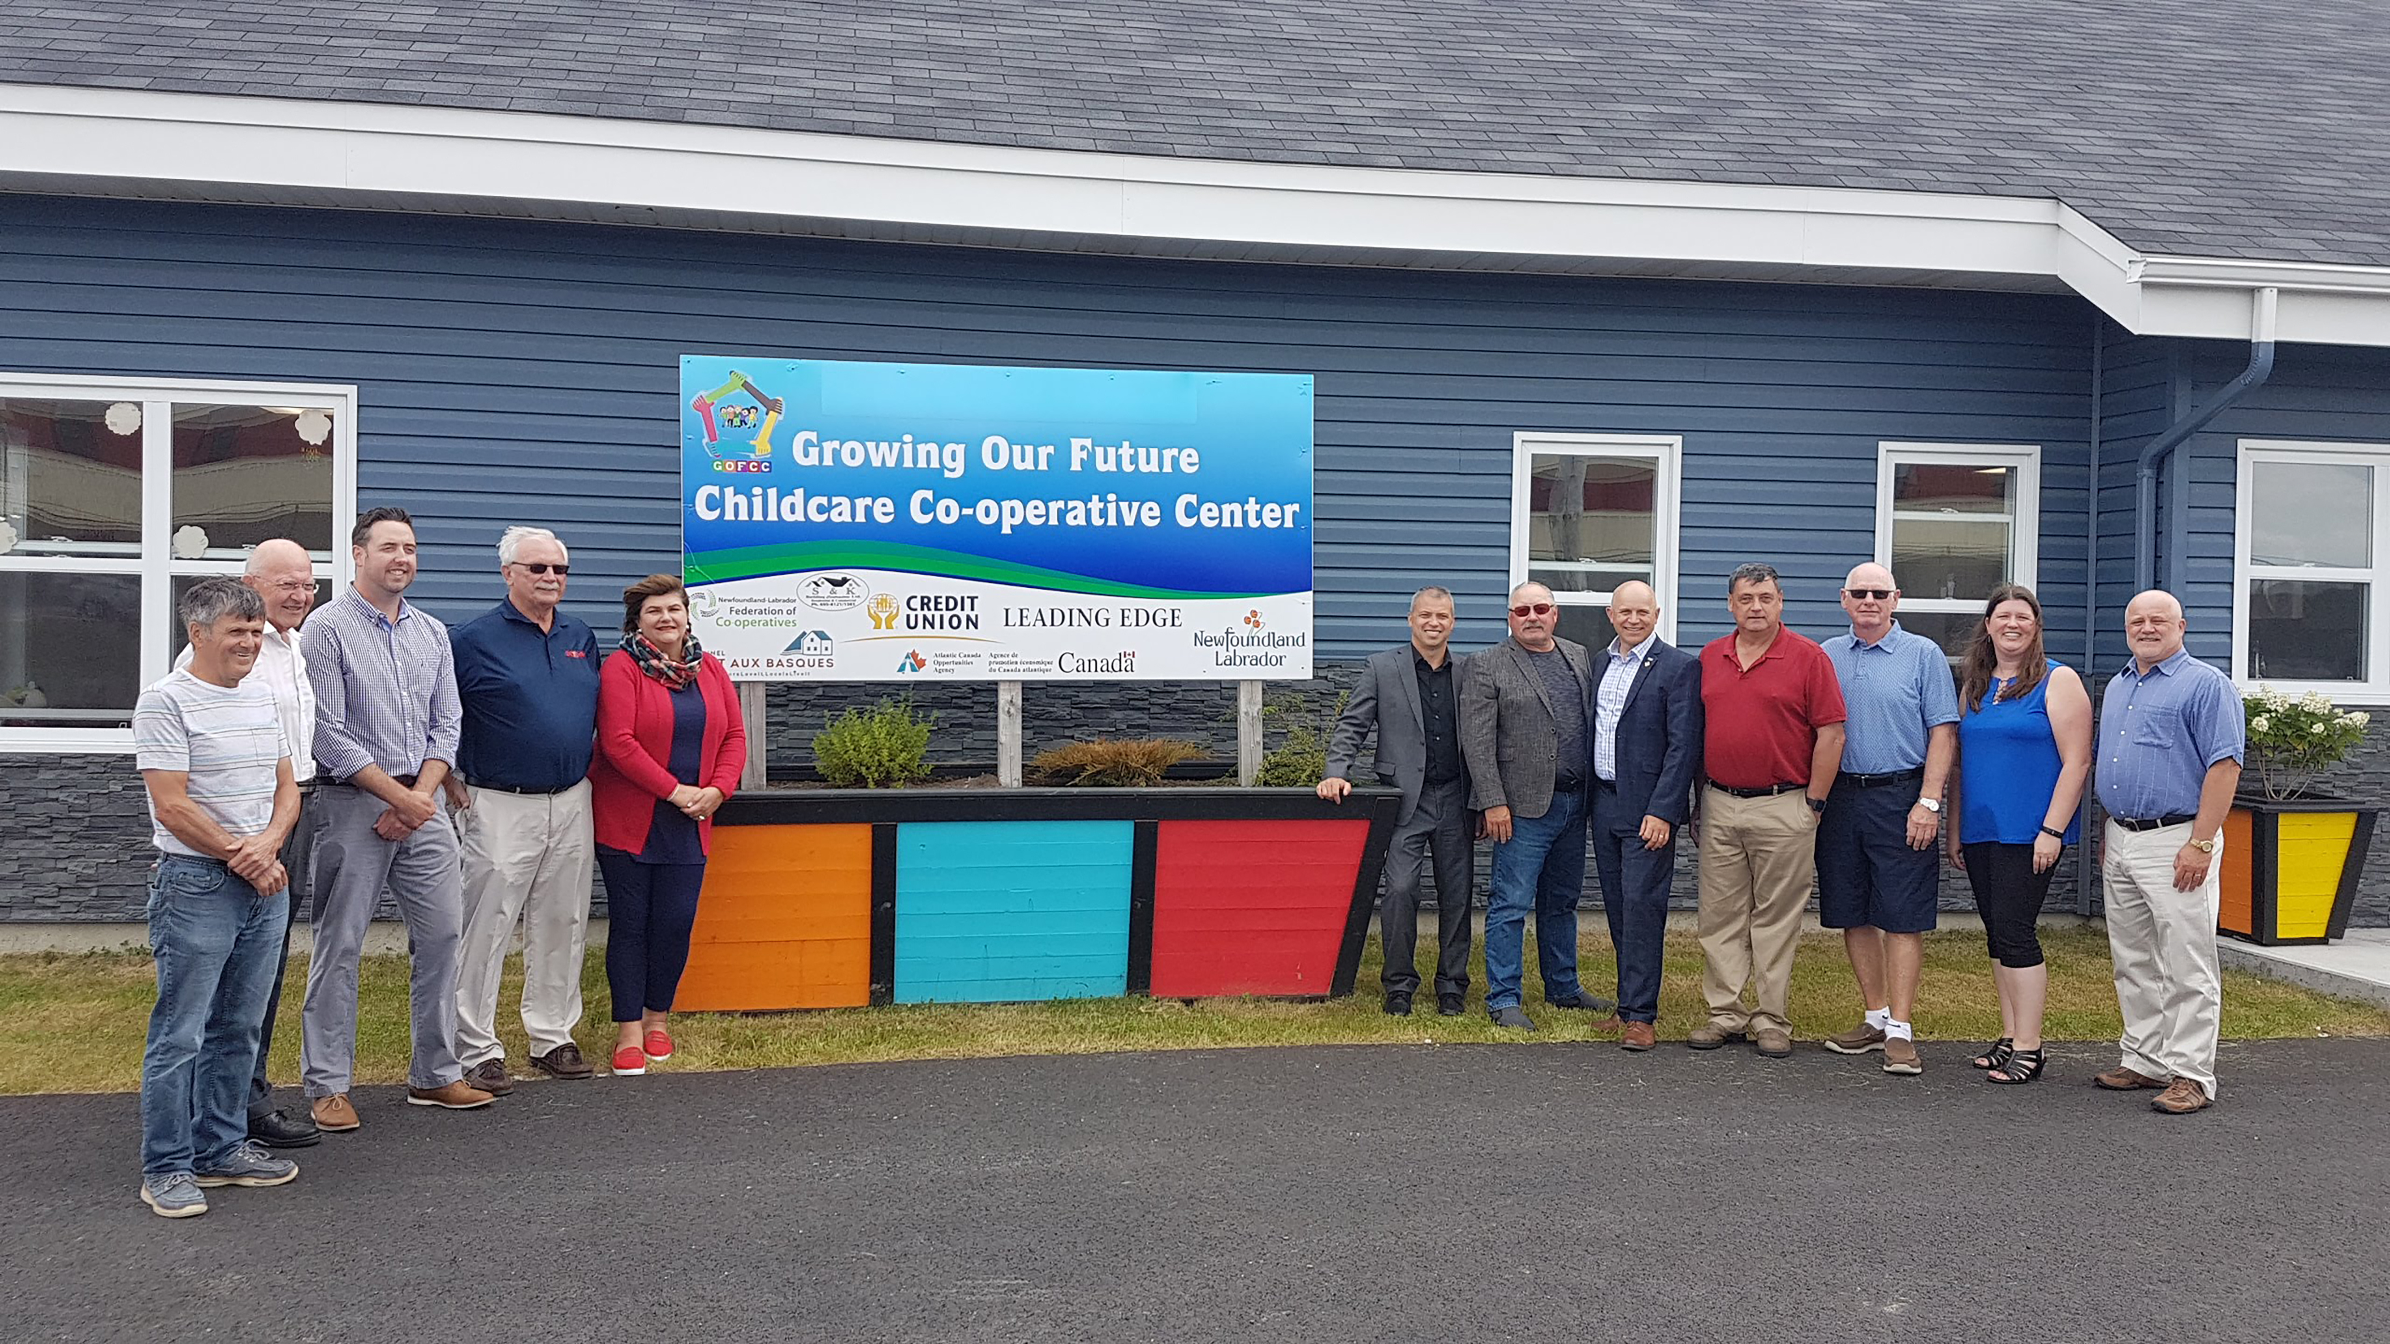
6.0 Become a Part of the Co-op Sector
6.3 Requirements for Success
    A strong link between membership and services provided
    A realistic feasibility assessment and business plan

Slide 32
6.0 Become a Part of the Co-op Sector
6.3 Requirements for Success
    Access to business financing (if required)
    An educated and well-functioning board of directors
    Ongoing member participation and communications
    A strong focus on member loyalty/commitment
    Effective community relations and partnership development
    Ensuring that business planning is an ongoing process

Slide 33
Steps in the Co-op Development Process
1. Opportunity Identification
  A co-op is often considered when people need a service and are knowledgeable about the benefits of the co-op model.
2. Initiating the Development Process
  A first step in initiating the development process is the formation of a steering committee.
3. Building the Co-op’s Structure
  The committee leads the process, including confirming business feasibility and development of the by-laws.

Slide 34
Steps in the Co-op Development Process
4. Developing the Business Plan
  Must be developed as a requirement for incorporation in Newfoundland and Labrador
5. Incorporation
  The committee submits an application for incorporation
6. Organizing and Launching the Business
  The committee oversees startup and operations until the first AGM and election of the first board of directors
7. Ongoing Operations
  The Board of Directors oversees operations on an ongoing basis

Slide 35
Questions/Comments?
Thank you!
Contact Information

