Slide 1

Presenter:

Slide 2
Best Practices
Firefighter Cancer Prevention
Lesson Goal
After completing this lesson, the student shall be able to promote and facilitate cancer prevention methods and best practices that relate to the fire service of the province.

Slide 3
Objectives
Upon successful completion of this lesson, the student shall be able to:
1. Discuss that effective preventative measures can help reduce the risks of cancer.
2. Discuss the steps used to develop a wellness/fitness program which will include physical exams, investigations and immunization.
3. Describe reasons to record events of exposure by the use of a detailed exposure report.
4. Identify and evaluate the need to support various best practices that can be employed by fire departments and others in the fire service industry for purposes of contamination control.
5. Discuss cleaning and decontamination of PPE.
6. Discuss the development of SOP for post fire decontamination.

Slide 4
Objective 1 — Identify the link between firefighting and cancer.

Slide 5
Section 1: Cancer Information
According to the International Association of Firefighters (IAFF), cancer is now the leading cause of death in IAFF firefighters
i. National Institute of Health and Safety (NIOSH) - 9 per cent more likely to develop cancer, 14 per cent higher to die from cancer
ii. Various types of fire, release toxic and carcinogenic substances
      Benzene
      Butadiene
      Formaldehyde
iii. With the increasing use of polymers in building construction and furnishings, there is concern that the burning of these new materials releases large quantities of other highly toxic substances.

Slide 6
Section 1: Cancer Information
Exposure
i. Firefighters are exposed to many known or suspected carcinogens
ii. Fire departments are encouraged to maintain training records and incident reports for the purpose of tracking each exposure
iii. Each fire department is encouraged to use this Prevention Guide to help mitigate the risk to their members

Slide 7
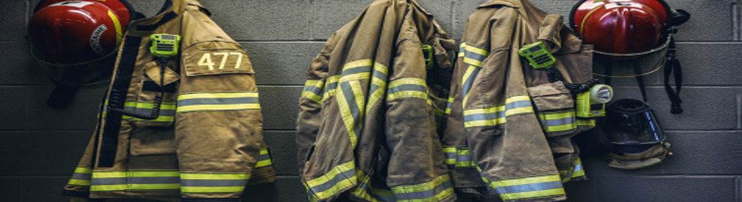
Section 1: Cancer Information
Recognized Standards
i. NFPA 1851 - Selection, Care and Maintenance of Protective Ensembles for Structural Fire Fighting
ii. NFPA 1500 - Fire Department Occupational Safety, Health and Wellness Program
iii. NFPA 1971 - Protective Ensembles for Structural Fire Fighting
iv. The garments manufacturer’s instructions.

Slide 9
Objective 2 — Identify ways Firefighters can do their part to help fight cancer by taking effective preventative measures that can help reduce the risks of cancer.

Slide 10
Section 2: Fight Against Cancer (Pledge)
Fight Against Cancer
1. In support of our fellow firefighters who have been diagnosed with and are in the midst of their fight against cancer, we would like to make every effort to support our extended families in any way possible.
2. We can do our part to help fight cancer by taking effective preventative measures that can help reduce the risks of cancer.

Slide 11
Section 2: Fight Against Cancer (Pledge)
I Pledge to:
i. Wear and use my Self-Contained Breathing Apparatus from initial attack to completion of overhaul.
ii. Do a field decontamination of my Personal Protective Equipment to remove as much of the bulk contamination as possible while still at the fire scene.
iii. Use wet wipes to remove as much soot as possible from my head, neck, jaw, throat, under arms and hands immediately
iv. Wash contaminated clothes as soon as practical, shower thoroughly after a fire and change into a clean cloths.
v. Clean all my PPE including gloves, hood, helmet, helmet liner, and turnout/bunker gear immediately after a fire.

Slide 12
Section 2: Fight Against Cancer (Pledge)
vi. Not take contaminated clothes or PPE home or store it in my vehicle.
vii. Decontaminate the fire apparatus interior, including my SCBA and other tools used at the fire.
viii. Keep turnout/bunker gear out of the apparatus interior, living and sleeping quarters.
ix. Make every effort to use sunscreen or sun block on all exposed skin.
x. Take responsibility for my health, annual medical examinations to help with early detection of cancer or other life changing diseases.

Slide 13
Objective 3 — Describe the steps used to develop a wellness/fitness program, which will include physical exams, investigations and immunization.

Slide 14
Section 3: Wellness/Fitness Program
Wellness/Fitness Program
1. Physical Exam
i. Vital Signs – BP, pulse, temperature, respirations, height and weight
ii. Head, ears, nose and throat exam
iii. Examination of the neck
iv. Cardiovascular, pulmonary, gastrointestinal and genitourinary (pap smear for females / digital rectal exam for men), lymph node and neurological exams.
v. Musculoskeletal / skin are also assessed.

Slide 16
Section 3: Wellness/Fitness Program
Wellness/Fitness Program
2. Investigations
i. Routine bloodwork
ii. Urinalysis dipstick and microscopic urinalysis sent to the lab.
iii. Vision, hearing and pulmonary testing.
iv. Chest X-ray and repeated as medically recommended.
v. Resting EKG with Stress EKG’s over 35
vi. Cancer Screening: Skin, breast, pap smears, (mammograms for females over 40 and PSA for males over 40) and fecal occult blood testing. (Colonoscopy if required).

Slide 18

Section 3: Wellness/Fitness Program
Wellness/Fitness Program
3. Immunizations
i. Immunization history reviewed, Hepatitis A - B, MMR, Tetanus, diphtheria, polio and tuberculosis initially.
ii. Any referrals that may be necessary are initiated.

Slide 19
Objective 4 — Explain reasons to record events of exposure by the use of a detailed exposure report.

Slide 21
Section 4: Exposure Report
Exposure Report
1. Document all training and emergency responses they have attended.
2. Information may be required by WorkPlace NL or Insurance Company.
3. Use some form of fire department record software program.
4. SOP/SOG’s require to ensure members are documenting all their incidents and training when exposed to hazards.

Slide 22
Section 4: Exposure Report
Documentation
Fully document all fire or chemical exposures on incident report form or personal exposure report forms.
i. Purpose
a. Document their exposure that they were exposed to at an incident.

Slide 23
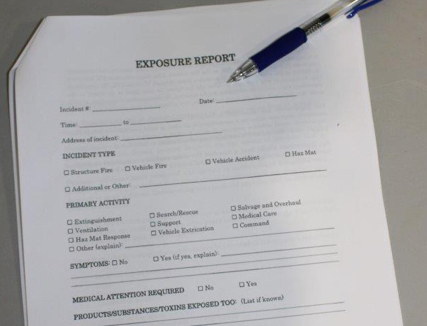
Section 4: Exposure Report
Documentation
Fully document all fire or chemical exposures on incident report form or personal exposure report forms.
ii. Scope
a. Fill out exposure report form after every incident and have the fire chief or designate sign the form once completed.

Slide 24
Section 4: Exposure Report
Procedure
All information should be provided on the exposure report form:
• Incident report number
• Date
• Time
• Location of incident
• Incident type
• Activity at the scene
• List any signs or symptoms you experience
• Medical attention required
• Did you seek medical attention after the incident?
• Length of exposure
• List PPE worn at the incident
• List any known products / toxins may have been at the incident

Slide 25
Objective 5 — Identify contamination types and possible locations of exposure.

Slide 26
Section 5: Fire Decontamination
Contamination Control
Best practices represent prevailing procedures that have been shown to provide benefits in achieving contamination reduction and control within the fire service as supported by different technologies or operational approaches.
Purpose
To convey the enormity of the problem and to describe the various forms of contamination that affect firefighter health and how these exposures occur and are aggravated with the fire service by controllable and non-controllable circumstances.

Slide 27
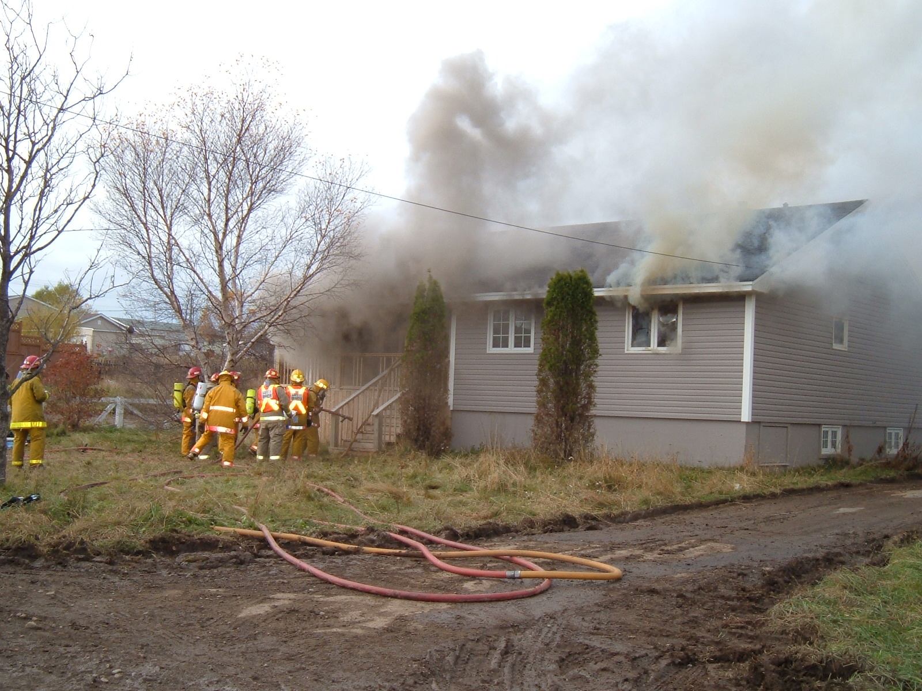
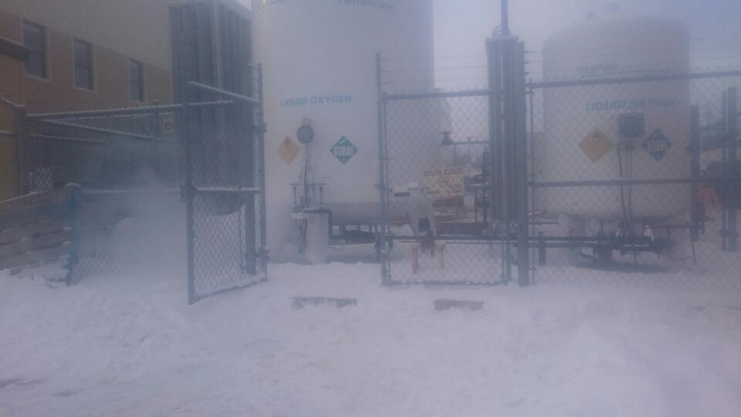
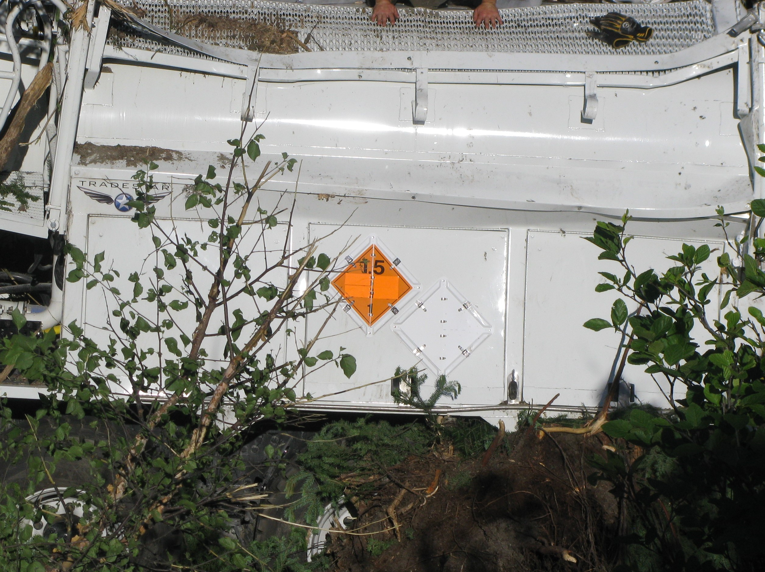
Section 5: Fire Decontamination
Contamination Types
i. Products of Combustion
ii. Chemicals
iii. Blood and Potentially Infectious Body Fluids
iv. Asbestos
v. Infectious Bacteria,
vi. Viruses, and Spores

Slide 28
Section 5: Fire Decontamination
Contamination Locations
i. On Fireground
ii. Inside Apparatus
iii. At Fire Station

Slide 29
Section 5: Fire Decontamination
Contaminated Items
i. Turnout Gear
ii. Fire hose
iii. Tools

Slide 30
Section 5: Fire Decontamination
Examples of Mitigation Methods
a. On Scene Gross Decontamination
b. Laundering of Turnout Gear
c. Source Capture of Apparatus Diesel Exhaust

Slide 31
Objective 6 — Identify and evaluate the need to support various contamination avoidance practices that can be employed by fire departments and others in the fire service industry.

Slide 32
Section 6: Contamination Control
Scope: Based on its review of existing or emerging best practices for contamination control, the following areas are specific targets for implementation;
• Contamination avoidance
• Gross decontamination at the emergency scene
• Cleaning and decontamination
• Wellness and health
• Apparatus design and cleaning
• Proper wearing of PPE
• Contaminated item handling
• Personal hygiene
• Documentation and record keeping
• Fire station design and maintenance

Slide 33
Section 6: Contamination Control
Note: It should be noted that research within the fire service is constantly evolving and the recommended practices may change. This is a current overview of recommended fire service best practices for contamination control.
Stress: Ultimately, best practices should be promoted to the fire service for addressing immediate concerns related to contamination control.

Slide 35
Objective 7 — Describe cleaning and decontamination of PPE, equipment, vehicles and personnel hygiene on scene and after returning to the hall.

Slide 36
Section 7: Cleaning and Decontamination of PPE, Equipment, Vehicles and Personnel
Cleaning and decontamination of PPE (On the Fire Scene)
A. Purpose
Provides a procedure that will remove the harmful chemicals and carcinogens accumulated through fire extinguishment and overhaul through on scene gross decontamination.
B. Responsibility
      Incident Command and/or the Safety Officer - before returning to the fire station.
      Driver/operator - establish the decontamination line.
      Individual firefighters - ensure they are decontaminated prior to removing facepieces, exchanging air bottles, or returning
      to the fire station.

Slide 37
Section 7: Cleaning and Decontamination of PPE, Equipment, Vehicles and Personnel
Equipment Needed
• 5-gallon bucket
• Baby wipes
• Garden hose
• Garden hose to 2 ½” adapter
• Nozzle or wand
• Mild detergent
• Heavy duty brush
• Heavy duty large trash bags

Slide 38
Section 7: Cleaning and Decontamination of PPE, Equipment, Vehicles and Personnel
Cleaning and decontamination of PPE (On the Fire Scene)
D. Procedures
Individuals performing the decontamination should wear
- Eye protection
- N-95 respirator
- Nitrile gloves
- Decontamination hose line will be charged to pump pressure only
- Prior to exchanging their air cylinders
- While they are still on air

Slide 39
Section 7: Cleaning and Decontamination of PPE, Equipment, Vehicles and Personnel
Cleaning and decontamination of PPE (On the Fire Scene)
Wet Decontamination Procedures
1. Add mild detergent to the brush.
2. Brush and wash off your gloves.
3. Close all pockets and flaps.
4. Slowly, without tipping it, remove and wash your helmet.
5. Clutch collar to minimize water entering through the neck opening.
6. With your hood in place, wash off your hood, facepiece, and regulator.
7. Wash your SCBA tank and connections.
8. While removing your facepiece be careful to keep it from any contaminated areas on your gear.
9. Wipe your face, neck, jaw and hands off with baby wipes or similar product.

Slide 40
Section 7: Cleaning and Decontamination of PPE, Equipment, Vehicles and Personnel
Cleaning and decontamination of PPE (On the Fire Scene)
Dry Decontamination Procedures
Caution: During cold inclement weather, the process of soaking firefighters while performing a wet decontamination may create additional safety hazards such as hypothermia, and equipment failure.
1. Brush off all large particles from the PPE, working from the head down.
2. Use damp towels to wipe the area around the firefighter’s facepiece to suspend any particulate matter.
3. Attempt to remove all of the visible contaminants.

Slide 41
Section 7: Cleaning and Decontamination of PPE, Equipment, Vehicles and Personnel
Cleaning and decontamination of PPE (On the Fire Scene)
Post Activity Decontamination on Scene
1. Individuals should wear eye protection, minimal N-95 respirator, and nitrile gloves.
2. All equipment and hose will be hosed down thoroughly prior to being placed on the apparatus.
3. PPE should be doffed, sprayed, brushed with mild detergent, and rinsed off.
4. All PPE should be placed in a trash bag in order to reduce contamination of the interior of the apparatus.
5. Wipe your face and hands off with baby wipes.

Slide 42
Section 7: Cleaning and Decontamination of PPE, Equipment, Vehicles and Personnel
Cleaning and decontamination of PPE (At the fire station)
Apparatus Decontamination, Cleaning and Disinfecting
1. All apparatus cabs, compartments and equipment
- weekly, after every incident or training
2. Parking upwind, keeping windows closed and heaters and air conditioners off
3. All cleaning can be done utilizing cleaning solutions, designated rags, mop buckets, brushes and disinfectants.
4. All PPE should be placed in a trash bag in order to reduce contamination of the interior of the apparatus.
5. Wipe your face and hands off with baby wipes.

Slide 43
Section 7: Cleaning and Decontamination of PPE, Equipment, Vehicles and Personnel
Cleaning and decontamination of PPE (At the fire station)
Apparatus Cab
1. Apparatus cab cleaning utilize a top-down cleaning/disinfecting method.
2. Special attention to computers, radios, map books, seats, steering wheel, floorboards and headsets.
3. Disinfecting is intended to prevent the spread of contagious illnesses.
4. Vacuum and/or steam extractor all cloth surfaces .
5. Remove all equipment and use the top-down method to clean apparatus compartments.

Slide 44
Section 7: Cleaning and Decontamination of PPE, Equipment, Vehicles and Personnel
Cleaning and decontamination of PPE (At the fire station)
Apparatus Cab
6. All equipment should be cleaned prior to being placed back on the apparatus.
7. Utilize the department’s cleaning program for the rags and mops.
8. Wash hands, face and neck or shower.

Slide 45
Objective 8 — Explain the development of a SOP for post fire decontamination.

Slide 46
Section 8: SOP for Post Fire Decontamination.
Post Fire Decontamination SOP
It is not possible to develop a SOP / SOG for every category listed previously that will fit the operation for every fire department. It is suggested that you use the Supporting Information from each category to develop your own.

Slide 47
Section 8: SOP for Post Fire Decontamination.
Post Fire Decontamination SOP
A. Purpose
To establish guidelines and procedures in an effort to combat the incidence of cancer among our members,
- giving consideration to recommendations contained current studies and reports,
- identified specific actions that will be required moving forward

Slide 48
Section 8: SOP for Post Fire Decontamination.
Post Fire Decontamination SOP
B. USE
The focus of this SOP is the health and well-being of each member of our fire department. Please remember to consider;
- your health,
- the health of your co-workers,
- and the impact that cancer can have on your family.

Slide 49
Section 8: SOP for Post Fire Decontamination.
Post Fire Decontamination SOP
C. PROCEDURES
• Proper use of PPE for structural firefighting is essential to the health and safety of all firefighters.
• The fire department shall provide each member with the appropriate PPE to provide protection from the hazards to which the member is or may be exposed.
• The SOP shall apply to all department personnel who will operate in and/or around hazardous work areas.

Slide 50
Section 8: SOP for Post Fire Decontamination.
Post Fire Decontamination SOP
1. General Procedures
2. Cleaning processes
3. Responsibility
4. Equipment Needed
5. Procedures
i. Wet Decontamination Procedures
ii. Dry Decontamination Procedures
iii. Post Activity Decontamination On Scene

Slide 51
SUMMARY
Ultimately, best practices should be promoted to the fire service for addressing immediate concerns related to contamination control.
• As best practices are further defined,
- they can become part of existing voluntary standards
- can be used by the fire service
- properly address the specific key element within a contamination control campaign
- create the awareness and tools for the fire service
- adoption of specific procedures, which can limit exposure to contamination.

Slide 52
SUMMARY
Contamination control is not a new concept for worker protection; however, in relation to certain types of contaminants, particularly products of combustion, serious changes are needed for fire and emergency services to overcome years of neglect.
• To aggressively reverse disturbing trends in the rise of cancer and other chronic diseases that are now being associated with exposure to persistent contaminants, these Best Practices are truly an effort that is needed to ensure that these changes continue well into the future.

Slide 53
Section 9: Contact Information
WorkplaceNL info@workplacenl.ca
St. John’s Corner Brook
Telephone 709.778.1000 Toll Free 1.800.563.9000 Telephone 709.637.2700 Toll Free 1.800.563.2772
Fax 709.738.1714 Fax 709.639.1018
Grand Falls-Windsor
Telephone 709.489.1600 Toll Free 1.800.563.3448
Fax 709.489.1616
Service NL, OHS Division NL Association of Fire Services
Telephone 709.729.2706 Office
Toll Free 1.800.563.5471 Telephone 709.424.6500
www.gov.nl.ca/dgsnl/links/#ohs office@nlfireservices.com

Slide 54
Section 9: Contact Information
Department of Justice and Public Safety
Fire Services Division
St. John’s
Telephone 709.729.1608
Fax: 709.729.2524

Slide 55


