Slide 1
NL Quarterly Job Vacancy Report
1st Quarter 2023
(January – March)
Department of Immigration, Population Growth and Skills - Workforce Development Secretariat

Slide 2
Important Notes
This report covers new monthly job postings that were captured by Lightcast between January and March 2023, reflecting the totals of these unique monthly job postings for this period.
All chart and table data in this report, including overall totals and percentage shares, are based only on postings that were able to be classified for the relevant indicator (e.g., occupation, industry, location, etc.); thus, totals vary across indicators. As an example, of the 7,959 postings recorded in Q1 for Newfoundland and Labrador, 7,783 were able to be classified at one of the five regional levels (meaning, 176 were unable to be classified beyond the provincial one). For this reason, the summed totals for postings in the five regions do not equal those presented for the province overall.
Job posting data are presented for Newfoundland and Labrador overall, as well as for each of the following regions: Labrador, Western, Central, Eastern, and Avalon. A map showing the approximate areas of geographic coverage for each of these regions is included in the charts for occupation.
Occupational data has been classified (where possible) using the 2016 National Occupational Classification (NOC) system.
Industry data has been classified (where possible) using the 2017 North American Industry Classification System (NAICS).
Education and experience levels (i.e., management, university, college, high school/occupation-specific training, and on-the-job training) are determined based on each job posting’s associated NOC code (where available). Details on this categorization can be found here.
Sought Skills/Qualifications cover a wide range of skills mentioned as requirements in individual job postings. Note that more than one skill or qualification can be advertised as a requirement for any individual job posting.
The current report provides commentary on notable findings in the first quarter of 2023. In addition, this report provides brief commentary on how these first quarter results compare to those for the previous year 2022.

Slide 3
Occupational
Comparisons

Slide 4
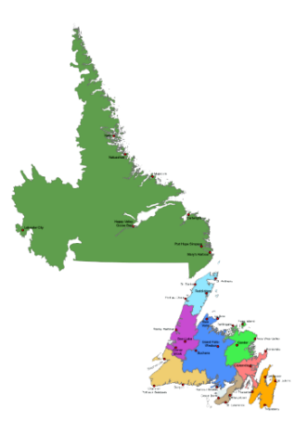
Top 10 Occupations Sought in 1st Quarter Job Postings (4-Digit NOC), Newfoundland and Labrador
Classified Job Postings for NL (January – March 2023): 7,505
Occupations most represented in the province’s job postings included those related to sales (retail salespersons, retail sales supervisors, sales and account representatives - wholesale); and food services (cooks, food and beverage servers).
Other areas represented in the top 10 included health (registered nurses); business (other business services managers); information services (other customer and information services representatives); and protection services (security guards and related).
Provincially, the occupation with the highest percentage of job postings was Retail Salespersons (2.9 per cent), followed by Other Customer and Information Services Representatives as well as Janitors, Caretakers and Building Superintendents (both at 2.7 per cent).
Note: Does not include percentage share associated with unclassified occupations.
Source: Lightcast Data (January – March 2023)
Notes:
14-10-0287-03

Slide 5
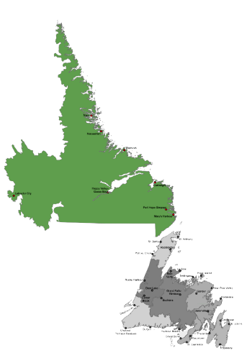
Top 10 Occupations Sought in 1st Quarter Job Postings (4-Digit NOC), Labrador Region
Classified Job Postings for Labrador (January – March 2023): 668
Occupations most represented in Labrador’s job postings included those related to engineering (civil engineers, industrial engineering technologists and technicians) and business (other business services managers, general office support workers).
Other areas represented in the top 10 included health (registered nurses); trades (heavy-duty equipment mechanics); protection services (security guards); and cleaning services (janitors, caretakers and building superintendents).
For the Labrador region, the occupations with the highest percentage of postings were Other Customer and Information Services Representatives (3.4 per cent) as well as Security Guards and Janitors,Caretakers and Building Superintendents (both at 2.8 per cent).
Note: Does not include percentage share associated with unclassified occupations.
Source: Lightcast Data (January – March 2023)
Notes:
14-10-0287-03

Slide 6
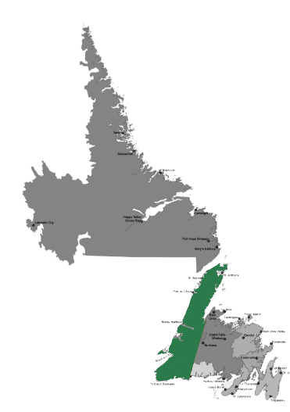
Top 10 Occupations Sought in 1st Quarter Job Postings (4-Digit NOC), Western Region
Classified Job Postings for Western (January – March 2023):
821
Occupations most represented in Western’s job postings included those related to sales (retail salespersons and retail sales supervisors); and health (registered nurses, home support workers, other assisting occupations in health).
Other areas represented in the top 10 included transportation (delivery and courier service drivers); cleaning services (janitors, caretakers and building superintendents), as well as business services (general office support workers) and financial services (banking and insurance clerks).
For the Western region, the occupations with the highest percentage of job postings were Registered Nurses and Registered Psychiatric Nurses (5.2 per cent) and Retail Salespersons (3.9 per cent).
Note: Does not include percentage share associated with unclassified occupations.
Source: Lightcast Data (January – March 2023)
Notes:
14-10-0287-03

Slide 7
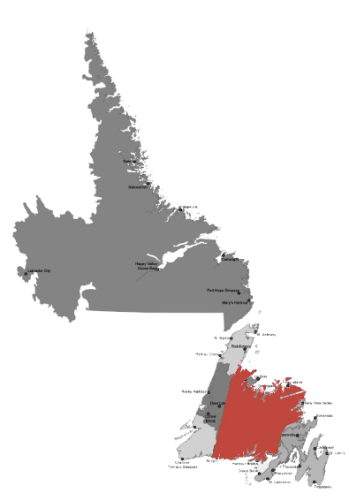
Top 10 Occupations Sought in 1st Quarter Job Postings (4-Digit NOC), Central Region
Classified Job Postings for Central (January – March 2023):
612
Occupations most represented in the Central region’s job postings included those related to sales (retail salespersons, sales and account representatives – wholesale trade).
Other areas represented in the top 10 were related to trades (automotive service technicians and mechanics); health (nurses); food services (food and beverage servers); information services (other customer and information services representatives); financial services (banking clerks); and cleaning services (janitors, caretakers and building superintendents).
For the Central region, the occupation with the highest percentage of job postings was Retail Salespersons (4.6 per cent), followed by Banking, Insurance and Other Financial Clerks (3.9 per cent).
Note: Does not include percentage share associated with unclassified occupations.
Source: Lightcast Data (January – March 2023)
Notes:
14-10-0287-03

Slide 8
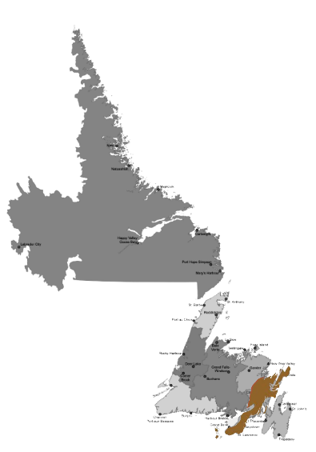
Top 10 Occupations Sought in 1st Quarter Job Postings (4-Digit NOC), Eastern Region
Classified Job Postings for Eastern (January – March 2023):
339
Occupations most represented in the Eastern region’s job postings included those related to health (registered nurses, allied primary health practitioners).
Other areas represented in the top 10 were related to merchandising (theatre, fashion, exhibit and other creative designers); sales (retail salespersons); information services (other customer and information services representatives); financial services (banking clerks); protection services (security guards); and cleaning services (janitors, caretakers and building superintendents).
For the Eastern region, the occupation with the highest percentage of job postings was Registered Nurses and Registered Psychiatric Nurses (5.0 per cent) followed by Retail Salespersons (4.7 per cent).
Note: Does not include percentage share associated with unclassified occupations. Examining the NOC Theatre, fashion, exhibit and other creative designers in NL job posting cases, it is determined that this mostly includes those working in promotional merchandising activities and setting up similar retail related displays.
Source: Lightcast Data (January – March 2023)
Notes:
14-10-0287-03

Slide 9
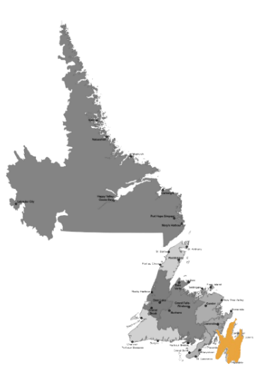
Top 10 Occupations Sought in 1st Quarter Job Postings (4-Digit NOC), Avalon Region
Classified Job Postings for Avalon (January – March 2023):
4,909
Occupations most represented in the Avalon region’s job postings included those related to sales (retail salespersons, retail sales supervisors, sales and account representatives – wholesale trade) and business (other business services managers, administrative assistants).
Other areas in the top 10 were related to health (registered nurses); transportation (delivery and courier service drivers); information services (other customer and information services representatives); and cleaning services (janitors, caretakers and building superintendents).
For the Avalon region, the occupation with the highest percentage of job postings was Retail Salespersons (2.8 per cent), followed by Other Customer and Information Services Representatives (2.6 per cent).
Note: Does not include percentage share associated with unclassified occupations.
Source: Lightcast Data (January – March 2023)
Notes:
14-10-0287-03

Slide 10
Occupation Highlights
The total number of job postings in the province that were able to be classified by occupation was 7,505. The Avalon region had the highest number of such postings (4,909) while the Eastern region had the lowest (339).
The occupations with the greatest number of job postings in the province were Retail Salespersons and Other Customer and Information Services Representatives. While these were also common in many regions (particularly the Avalon), others such as nurses, financial clerks and security guards were prominent in some regions.
The most common occupational areas represented in job postings were sales, health, and business. Engineering occupations were prevalent in Labrador.
Management positions were only prominent in the business domain (e.g., other business service managers). Supervisor positions in retail were also common, however.
A wide range of training and skill levels were represented in first quarter 2023 postings, including those with lower levels of skill requirement (salespersons, cooks) as well as more specialized skill requirements (registered nurses, civil engineers). In general, the range of occupations for this quarter appear to be more diverse than those in 2022. As an example, areas such as trades, engineering, protective and financial services were much more prevalent in this quarter.

Slide 11
Education and Experience Levels

Slide 12
Distribution of Education and Experience Levels Sought in 1st Quarter Job Postings, Newfoundland and Labrador
Total Job Postings for NL (January – March 2023): 7,505
Note: Does not include percentage share associated with unclassified occupations.
Source: Lightcast Data (January – March 2023)
Notes:
14-10-0287-03

Slide 13
Distribution of Education and Experience Levels Advertised in 1st Quarter Job Postings, Regional Data
 | Labrador | Western | Central | Eastern | Avalon
Management Experience | 10.9% | 7.6% | 7.8% | 3.5% | 11.6%
University Level | 21.0% | 20.0% | 14.9% | 24.5% | 20.7%
College Level | 36.8% | 30.3% | 34.2% | 33.6% | 32.3%
High School or Occupation-Specific Training | 24.3% | 30.9% | 32.8% | 29.5% | 25.9%
On-the-Job Training | 7.0% | 11.2% | 10.3% | 8.8% | 9.5%
Total Postings | 668 | 821 | 612 | 339 | 4,909
Note: Does not include percentage share associated with unclassified occupations.
Source: Lightcast Data (January – March 2023)
Notes:
14-10-0287-03

Slide 14
Education and Experience Highlights
In terms of education and experience levels, college education and high school or occupation-specific training were the most heavily represented in the job postings for the first quarter of 2023 (32.8 per cent and 27.3 per cent, respectively).
The lowest percentage shares were for job postings requiring on-the-job training (9.5 per cent) and management experience (10.3 per cent). Job postings requiring university level education were higher than for these two categories (20.1 per cent) but lower than those for college education and high school or occupation-specific training.
All regions had over 30 percent of their job postings requiring college level education, with the highest being Labrador (36.8 per cent). This may be partly due to the higher number of jobs requiring specialized training (trades, engineering, health, business, etc.) in this region.
Likewise, several regions had a high percentage of job postings requiring either management experience or some form of post-secondary education, including Labrador (68.7 per cent); Eastern (61.7 per cent); and Avalon (64.6 per cent). The overall percentage for the province was 63.2 per cent.
Postings requiring management experience made up approximately 8 to 12 per cent in most regions, with the exception of Eastern where it was less than 4 per cent.

Slide 15
Industry Profile

Slide 16
Distribution of Industry Sectors for 1st Quarter 2023 Job Postings (2-Digit NAICS), Newfoundland and Labrador
Classified Job Postings for NL (January – March 2023): 4,657
Note: Does not include percentage share associated with unclassified industries.
Source: Lightcast Data (January – March 2023)
Notes:
14-10-0287-03

Slide 17
Distribution of Industry Sectors Advertised in 1st Quarter 2023 Job Postings,
Regional Data (1/2)
 | Labrador (n=417) | Western (n=464) | Central (n=388) | Eastern (n=215) | Avalon (n=3,050)
Agriculture, Forestry, Fishing and Hunting | 0.7% | 0.6% | 0.8% | 0.0% | 0.9%
Mining, Quarrying, and Oil and Gas Extraction | 0.0% | 0.0% | 0.3% | 0.0% | 5.4%
Utilities | 6.0% | 0.6% | 2.1% | 0.0% | 2.8%
Construction | 1.7% | 3.0% | 1.5% | 0.9% | 4.2%
Manufacturing | 2.6% | 2.2% | 5.4% | 0.9% | 3.2%
Wholesale Trade | 3.1% | 4.7% | 3.1% | 0.0% | 2.7%
Retail Trade | 4.1% | 21.3% | 19.8% | 15.3% | 18.9%
Transportation and Warehousing | 9.1% | 7.5% | 1.8% | 0.5% | 4.2%
Information and Cultural Industries | 0.5% | 3.4% | 2.6% | 2.3% | 3.0%
Finance and Insurance | 6.5% | 15.5% | 10.3% | 15.3% | 5.5%
Note: Does not include percentage share associated with unclassified industries.
Source: Lightcast Data (January – March 2023)
Notes:
14-10-0287-03

Slide 18
Distribution of Industry Sectors Advertised in 1st Quarter 2023 Job Postings,
Regional Data (2/2)
 | Labrador (n=417) | Western (n=464) | Central (n=388) | Eastern (n=215) | Avalon (n=3,050)
Real Estate and Rental and Leasing | 1.4% | 2.6% | 1.3% | 0.5% | 2.4%
Professional, Scientific, and Technical Services | 20.6% | 7.5% | 9.8% | 10.2% | 9.9%
Management of Companies and Enterprises | 0.0% | 0.0% | 0.0% | 0.5% | 0.2%
Administrative & Support/Waste Management/Remediation Services | 4.3% | 5.2% | 5.7% | 9.8% | 7.1%
Educational Services | 8.2% | 5.2% | 3.1% | 3.7% | 5.5%
Health Care and Social Assistance | 21.1% | 3.4% | 19.1% | 28.4% | 10.1%
Arts, Entertainment, and Recreation | 0.0% | 0.0% | 0.0% | 0.0% | 0.9%
Accommodation and Food Services | 2.6% | 8.6% | 4.4% | 5.6% | 6.2%
Other Services (except Public Administration) | 3.8% | 3.7% | 4.4% | 2.3% | 2.7%
Public Administration | 3.6% | 4.7% | 4.6% | 3.7% | 4.1%
Note: Does not include percentage share associated with unclassified industries.
Source: Lightcast Data (January – March 2023)
Notes:
14-10-0287-03

Slide 19
Industry Highlights
The total number of new provincial job postings that were able to be classified by industry during the first quarter of 2023 was 4,657. Within Newfoundland and Labrador, the Avalon region had the highest number of such postings (3,050) while the Eastern region had the lowest (215).
The industries with the highest percentage share of job postings during this time period were Retail Trade (17.3 per cent); Health Care and Social Assistance (11.9 per cent); Professional, Scientific and Technical Services (10.8 per cent); and Finance and Insurance (7.4 per cent).
The Central and Western regions had a higher share of postings in Retail Trade (19.8 per cent and 21.3 per cent), although all regions had over 15 per cent of their postings in this area, with the exception of Labrador (4.1 per cent).
In contrast, the Labrador region had a much higher percentage of job postings in Professional, Scientific, and Technical Services (20.6 per cent) than did all other regions of the province (approximately 10 per cent or less in each case).
The Labrador and Eastern regions had a higher percentage of job postings in Health Care and Social Assistance than did the other regions of the province (21.1 per cent and 28.4 per cent, respectively), All other regions except Western (3.4 per cent) had between 10 to 20 per cent in this sector.
Lastly, Western and Eastern had the highest percentage share of job postings in Finance and Insurance (15 to 16 per cent), while all other regions had approximately 6 to 10 per cent.

Slide 20
Employer Sought Skills/Qualifications

Slide 21
Most Popular Skills/Qualifications Sought in 1st Quarter Job Postings,
Newfoundland and Labrador
Note: Does not include percentage share associated with unclassified cases.
Source: Lightcast Data (January – March 2023), represents those with one per cent or greater mentions (i.e., 396 and greater mentions during this quarter)
Notes:
14-10-0287-03

Slide 22
Skills/Qualifications Highlights
The top skills and qualifications sought in Newfoundland and Labrador job postings during the first quarter of 2023 were: Communications; Customer Service; Management; Operations; and Detail Oriented. As in previous quarters, Communication ability showed up several times in the top skills sought (including interpersonal communications, verbal communication, and writing), suggesting its overall importance to a variety of jobs and workplace environments.
Both technical skills and transferable skills were well represented on the list of top skills and qualifications provincially. For instance, technical skills on the list included: valid driver’s license; software skills (Microsoft Office, Excel, etc.); accounting skills; and computer literacy, in general. For more transferable skills, notable entries included: time management skills, planning, problem solving, leadership, and multi-tasking.
Many of the top skills sought in the regions were similar to those at the provincial level (including heavy focus on different forms of communication skills):
The top skills and qualifications sought in the Labrador region were: Communications; Operations; Customer Service; Valid Driver’s License; and Problem Solving Skills.
In the Western region were: Customer Service; Communications; Sales; Detail Oriented; and Management Skills.
In the Central region were: Customer Service; Communications; Sales; Detail Oriented; and Interpersonal Communication Skills.
In the Eastern region were: Communications; Customer Service; Writing; Sales; and Detail Oriented.
In the Avalon region were: Communications; Customer Service; Management; Operations, and Detail Oriented.

Slide 23
Comparison: 1st Quarter 2023 to 2022 Annual
The number of postings for the first quarter of 2023 was higher than for the same quarter in 2022. In the case of classified postings by occupation, there were almost 1,500 more postings in the current quarter than in the same quarter of last year (7,505 compared to 6,017). Avalon continues to have the highest number of postings and Eastern the lowest (as was the case in all quarters of 2022).
In 2022, the most prominent occupations were Retail Salespersons and Other Customer and Information Services Representatives. While these occupations were represented in the first quarter of 2023 as well, there were several others that were also represented (such as nurses, security guards and banking clerks).
Management positions in the first quarter of 2023 were largely restricted to the business sector while supervisor positions were tied to retail. In general, management positions seem to be less represented in a wide number of areas as compared to in 2022.
On the other hand, a more diverse range of training and skill levels were represented in first quarter postings for 2023. While some areas were similar to those for 2022 (registered nurses, business services managers), others are relatively new to the top ten (various trades, engineering jobs, and jobs in areas such as protective and financial services; e.g., security guards, banking clerks, etc.).

Slide 24
Comparison: 1st Quarter 2023 to 2022 Annual
College education and high school or occupation-specific training were again the most represented in job postings for the first quarter of 2023, with those for university slightly below these two. In fact, postings for college education occupations were over 30 per cent in all regions for the first quarter of this year (similar to that for some quarters of 2022). Furthermore, the number of regions with over 60 per cent of postings requiring management experience or post-secondary education was higher in this quarter than in most quarters of 2022.
The industries with the highest percentage share of postings for this first quarter were largely similar to those seen in various quarters of 2022 (Retail Trade, Health Care and Social Assistance, and sometimes Professional, Scientific and Technical Services). The main difference in the first quarter of 2023 was a higher percentage of postings in Finance and Insurance (while 2022 typically saw a greater percentage of postings in Accommodation and Food Services).
The top skills and qualifications in the first quarter of 2023 were largely the same as those for 2022, at both the regional level and provincial (although the order of the top five has sometimes changed). For instance, in both 2022 and the first quarter of 2023, Communication was a frequent skill and qualification mentioned in postings.

