Slide 1
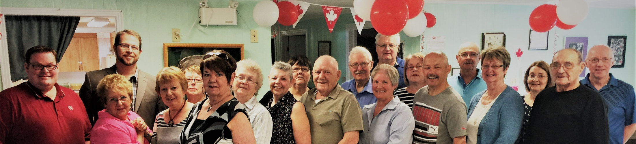

Age Friendly Grand Falls-Windsor
Making Your Community More Age-Friendly
Oct 14, 2021

Slide 2
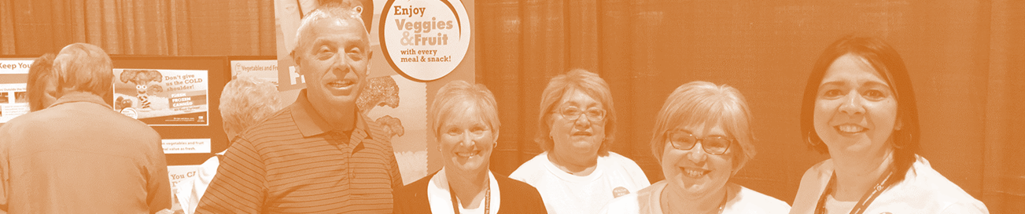
Grand Falls-Windsor Age Friendly Steering Committee
Formed in 2010
Nationally accepted Age Friendly Rural and Remote Communities: A Guide
Developed a series of recommendations for the Town
Built on principles of dignity, self fulfillment, social inclusion, independence, safety and security and fairness

Slide 3
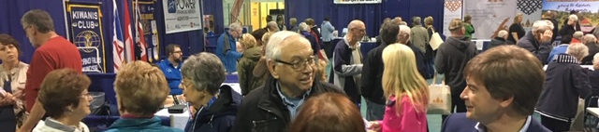
8th Annual Seniors Fair:
Social participation
Connecting business
Connecting community groups
Education
600 attendees
40 Exhibitors

Slide 4
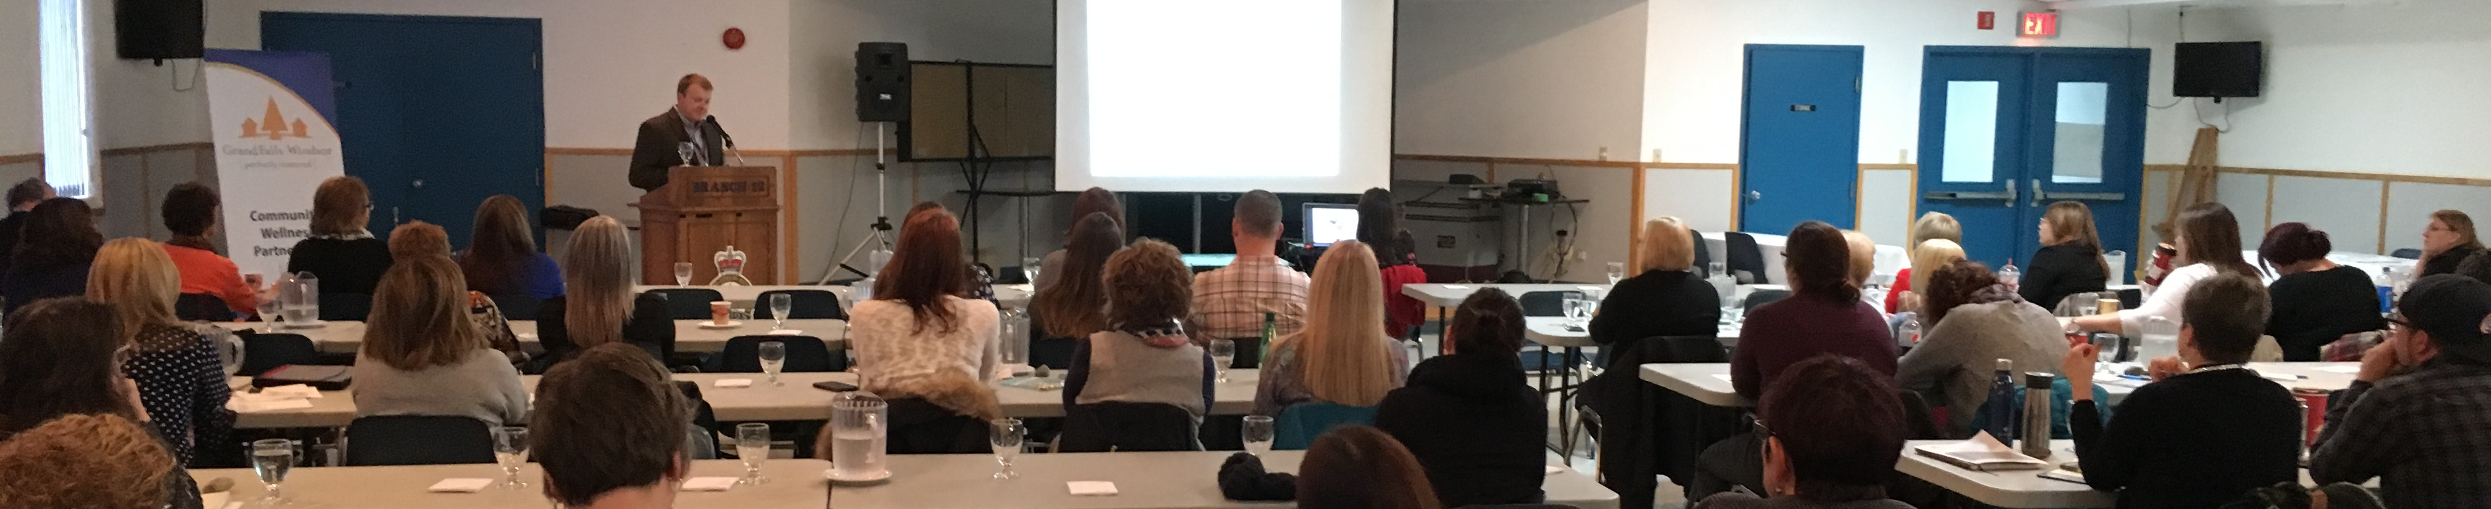
Seniors and Mental Health, A Focus Area
Seniors Rural Mental Health Conferences
Seniors Social Isolation Conference
Hearing impairment
Learning the Ropes Program: Optimizing cognitive health
In 2020
Seniors Mental Health Stakeholder Conference
Impact of music training on cognitive abilities in older adults- Research Project

Slide 5
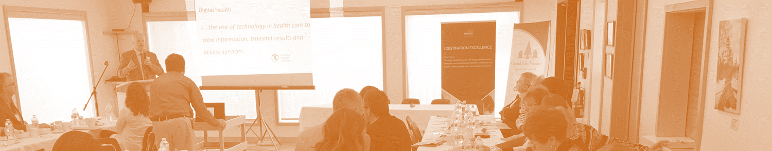
Grand Falls-Windsor Digital Health Platform
Bringing online health resources in Grand Falls-Windsor together.
Local experts contributing information
McMaster University Optimal Aging Portal

Slide 6
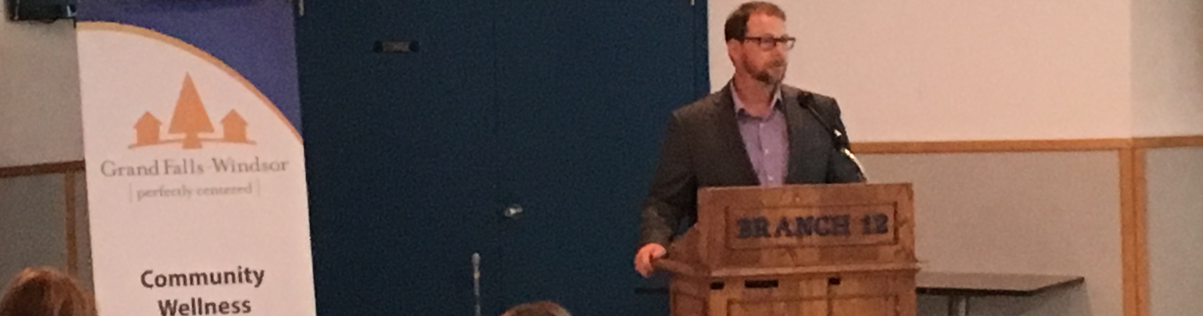
The Town of Grand Falls-Windsor Age Friendly Initiatives
Exceptional Partnerships: Central Health, Community Groups
Exceptional People: Volunteers and professionals
Focused Projects
Directly Supports
The Way Forward: Improve Health Outcomes for Those in Rural and Remote Areas

Slide 7
Age Friendly Grand Falls-Windsor
Thank you

