Slide 1
Making Your Community More Age-Friendly
Thank you for joining us today.
Please ensure your microphone is on mute.
The webinar will begin shortly.

Slide 2
Some questions to be answered…
What is an age-friendly community?
Why should our community become more age-friendly?
How do we get started?
What have other communities done?

Slide 3
An Age-Friendly community is …
…a community where policies, services and structures related to the physical and social environment are designed to support and enable people of all ages to live in a secure environment, enjoy good health, and continue to participate fully in society.
(World Health Organization)

Slide 4
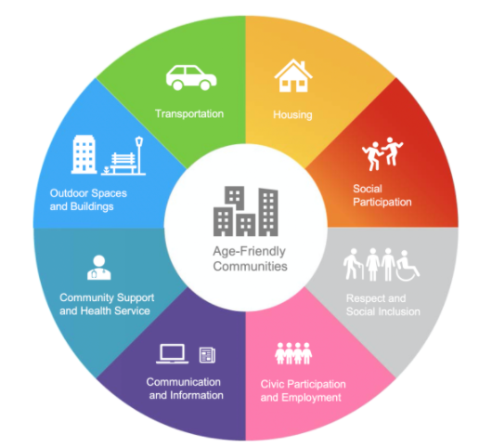
Age-Friendly Domains
Notes:
outdoor areas and public buildings are safe and accessible;
housing is affordable and supports aging in place;
roads and walkways are accessible and kept in good shape;
public transportation is affordable and accessible;
relationships are respectful (within and across generations);
health and community support services are available;
individuals can take part in volunteer, political and employment positions regardless of age or ability; and
information is easy to find and easy to understand.

Slide 5
Universal Design
Universal design is the design and structure of physical and social environments so they can be understood, accessed, and used to the greatest extent possible by all people regardless of age or ability.

Slide 6
Principles of universal design
Principle 1: Equitable Use
Principle 2: Flexibility in Use
Principle 3: Simple and Intuitive Use
Principle 4: Perceptible Information
Principle 5: Tolerance for Error
Principle 6: Low Physical Effort
Principle 7: Size and Space for Approach and Use

Slide 7
Why should our community become more age-friendly?
Being age-friendly helps make a community a community of choice for all generations:
Individuals are supported to age in place.
Healthy, active aging reduces need for health care services.
Barrier-free buildings (including businesses) and spaces enhance the mobility for people of all abilities, and all ages.
The whole community benefits from the participation of older persons in volunteer or paid work and civic activities.

Slide 8
Why should my business become more age-friendly?
Age-friendly businesses attract and keep customers and employees as demographics change.
An age-friendly business promotes:
Safety and accessibility
Comfort
Respect
Intergenerational mentoring and knowledge exchange

Slide 9
Demographic Change Includes…
Net migration
Urbanization
Birth/death rates
Life expectancy
Family structures
Population aging

Slide 10
Net Migration, 1972 to 2040p
Source: Statistics Canada; Department of Finance

Slide 11
Urbanization Expected to Continue
Source: Statistics Canada; Department of Finance, Medium Scenario, November 2020. https://www.gov.nl.ca/fin/economics/pop-projections/

Slide 12
Natural Population Change 1949-2040P
Source: Statistics Canada; Department of Finance

Slide 13
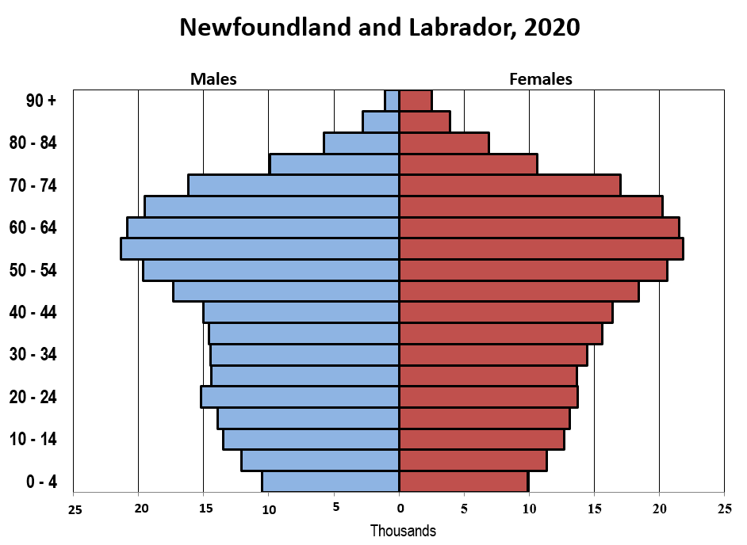
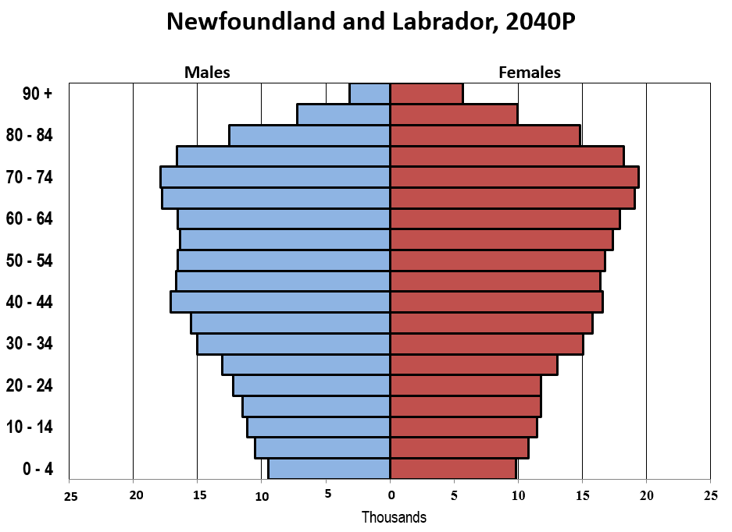
Changing Age Structure
Year | Total Population
2020 | 522,103
2040 | 528,026
Population Age 0 to 24
2020 - 125,868 (24%)
2040 - 110,264 (22%)
Population Age 65+
2020 - 116,228 (22%)
2040 - 162,114 (31% )
Source: Department of Finance, Medium Scenario, November 2020
Notes:
ROBERT

Slide 14

Population Aging
“Population aging is a human success story, reflecting the advancement of public health, medicine, and economic and social development, and their contribution to the control of disease, prevention of injury, and reduction in the risk of premature death.”
“Population aging ….has implications for nearly all sectors of society, including labour and financial markets, the demand for goods and services, such as housing, transportation and social protection, as well as family structures and intergenerational ties.”
United Nations, World Aging Report, 2019

Slide 15
How do we get started? Age-Friendly Community Milestones
Establish an advisory committee
Secure commitment of local government
Assess
Develop an age-friendly action plan
Measure and report publicly on actions

Slide 16
Funding Opportunities
Age-Friendly Newfoundland and Labrador Communities Program Deadline November 19, 2021
Newfoundland and Labrador Community Transportation Program Deadline November 19, 2021
Community Healthy Living Fund
Deadline December 31, 2021
Newfoundland and Labrador Seniors’ Social Inclusion Initiative and New Horizons for Seniors Program
Notes:
And resources – nationally and locally

Slide 17
Municipal Funding
Canada Community Building Fund (previously knows as Gas Tax)
Capacity Building – projects to strengthen the ability of Local Governments to develop long-term planning practices
Public Transit – infrastructure that supports a shared passenger transport system which is available for pubic use
Recreational, Sport, Cultural, and Tourism Infrastructure
Potential opportunities to leverage funding with Age-Friendly Communities and Community Transportation Program

Slide 18
Municipal Planning
Land-use Planning
Municipal Plans (Policies)
Development Regulations (Rules/By-Laws)
Five Year Review Cycle
Ten Year Development Cycle
Emergency Management Planning
Budget Planning

Slide 19
Random Age-Friendly Communities – Clarenville

Slide 20
Age Friendly Grand Falls-Windsor

Slide 21
Age Friendly Placentia

Slide 22
Contact Information
Seniors and Aging Division (CSSD)
Email: aging-and-seniors@gov.nl.ca
Toll Free: 1-888-494-2266
Land Use Planning Division
Email: landuseplanning@gov.nl.ca
Phone: (709) 729-3090
Canada Community Building Fund
Toll Free: 1-877-729-4393
Email: gastax@gov.nl.ca

