Slide 1

Active at Work Toolkit
Brought to you by the Government of Newfoundland and Labrador and ParticipACTION

Slide 2

Presenters
Erin Brown, Marketing Specialist
Jon Malton, Director of Partnerships

Slide 3





Webinar Housekeeping
Active webinar
Guests are Muted
We encourage you to move, stretch and be active while you listen and engage
Recording and resources will be shared
Q & A session to follow

Slide 4
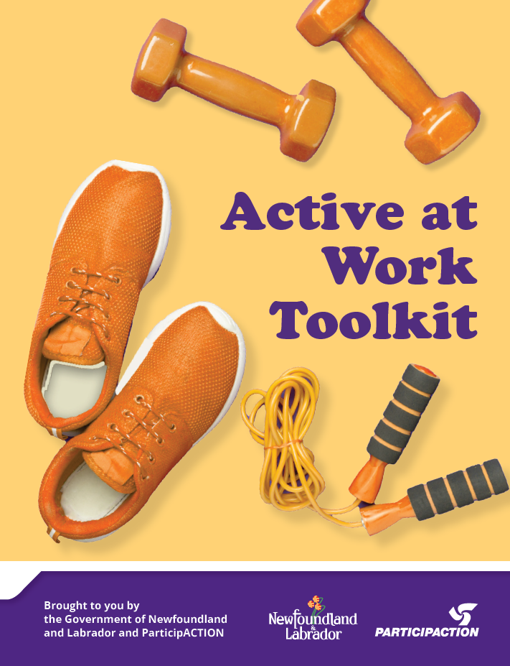
Agenda
Overview Of The Toolkit
Why Is The Toolkit Important
How to Get Active During the Workday
Resources Available
Fit Break
Where Can You Access the Toolkit
Questions?

Slide 5


What is the Toolkit?
Partnership between ParticipACTION and The Government of Newfoundland and Labrador
Information and resources for employees and partners to support active living during the workday
Integrates key messages and learnings from ParticipACTION’s campaign; Fall in with an active crowd

Slide 6
Why is the Toolkit Important?
Most adults spend large parts of their lives working and so the workplace is an ideal environment for introducing healthy habits that can improve overall health and well-being.
Benefits of getting active during the workday include; improved brain function, quality of life, sleep, and physical and mental health.
Employee health directly impacts organizational health as it can result in increased productivity, more meaningful employee interactions, lower injury rate, reduced absenteeism and decreased health-care costs.
Support from leadership is essential to foster an active, healthy work culture, increase organizational performance, enhance public image and improve employee retention.

Slide 7
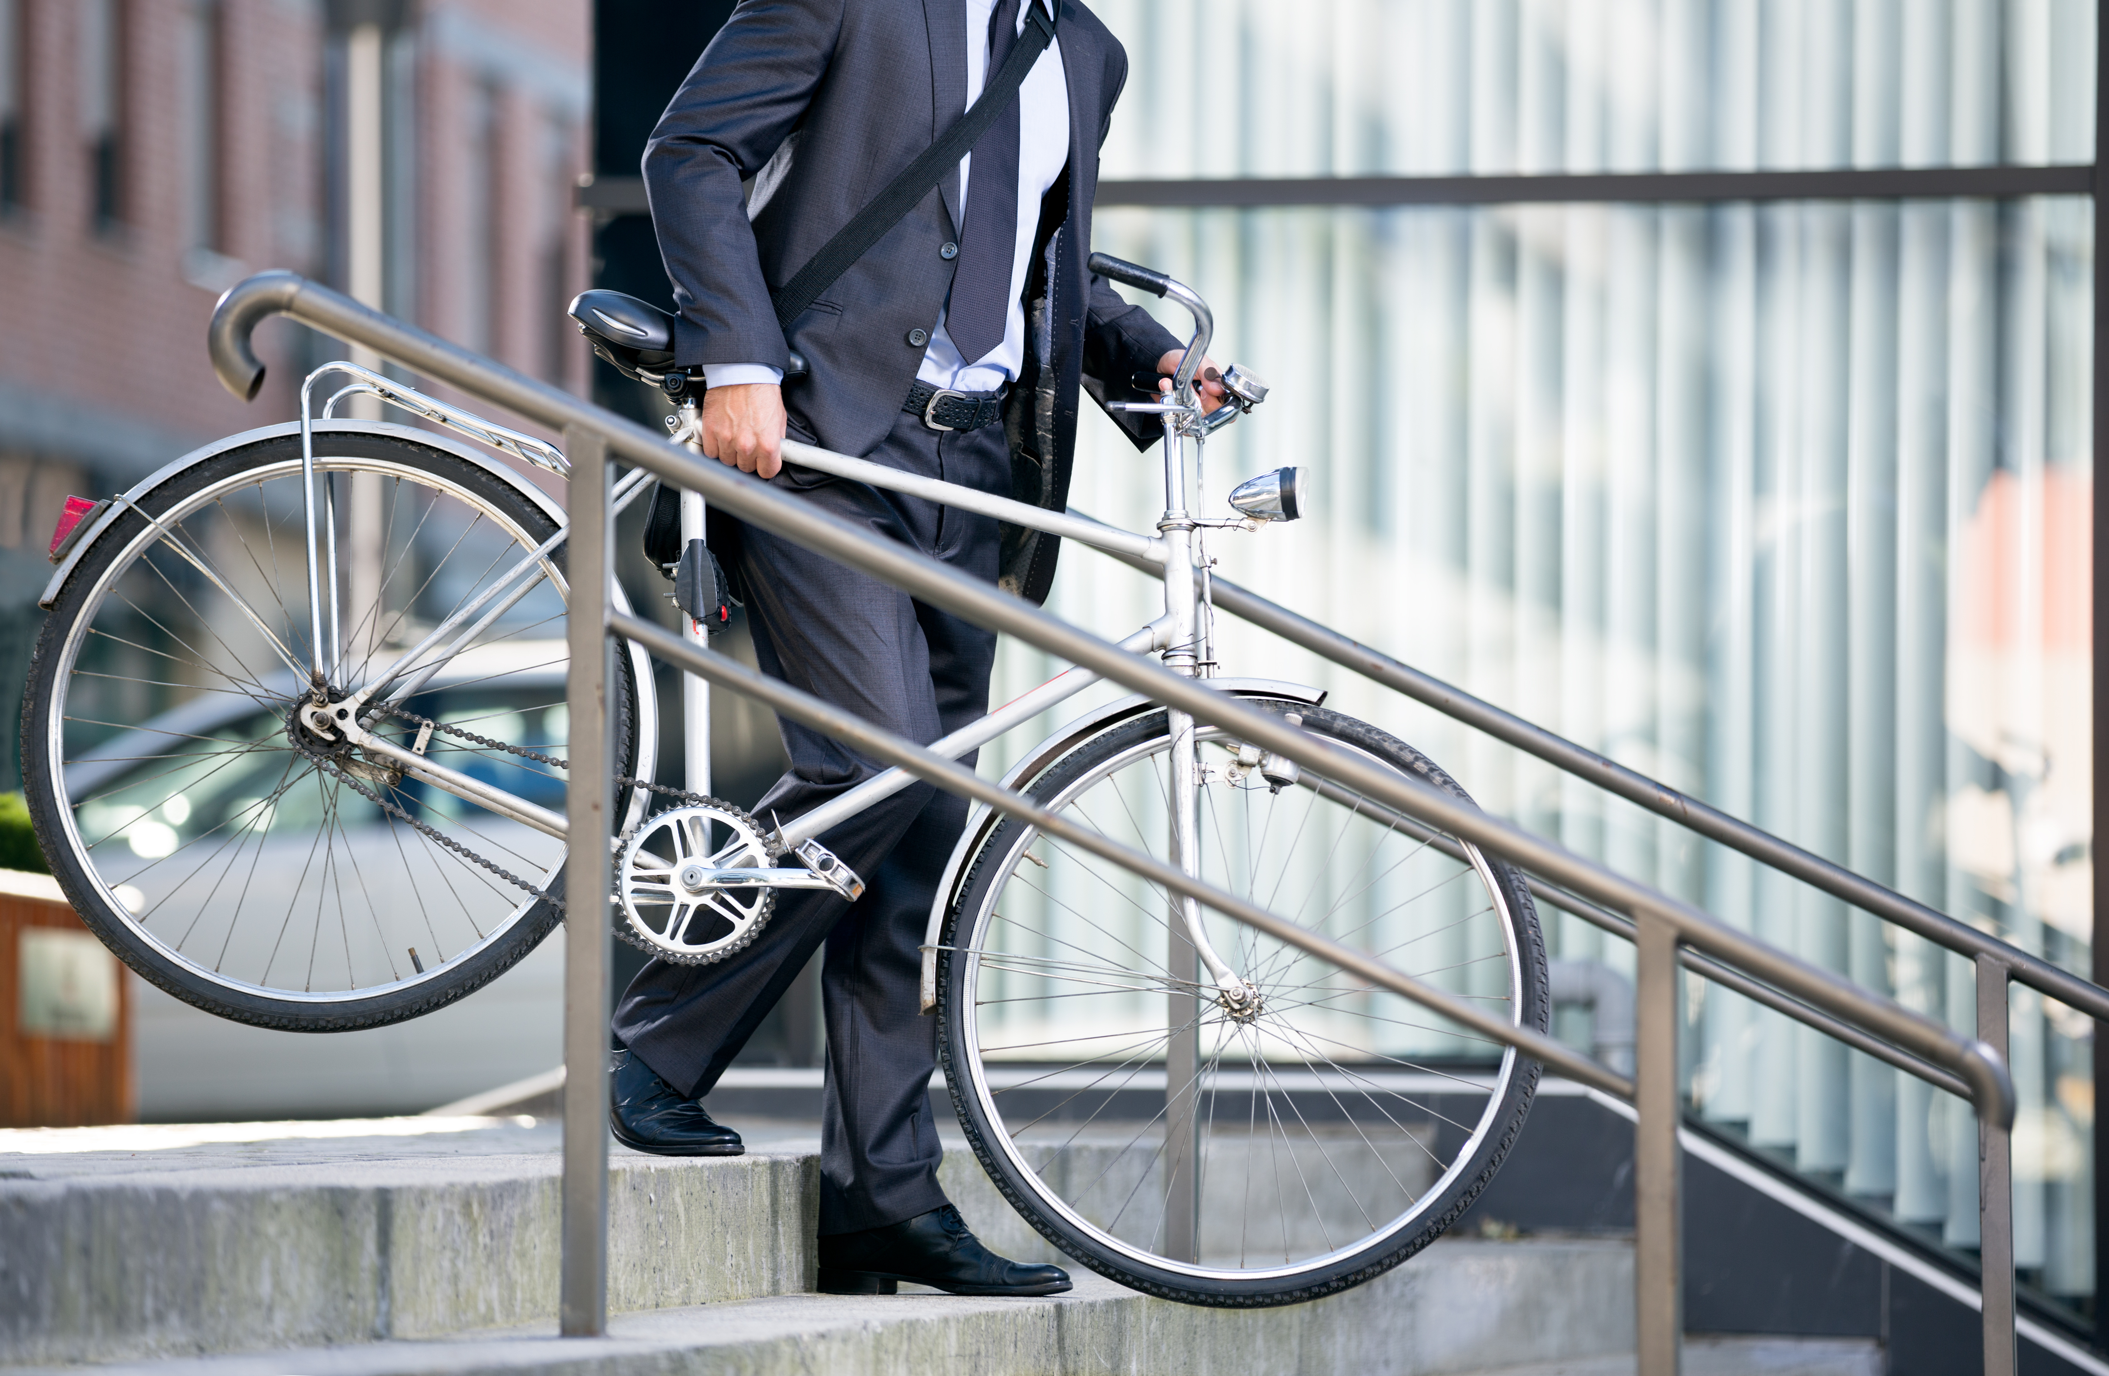
How to Get Active During the Workday
Make meetings active
Encourage standing meetings or take meetings outdoors if possible.
Use active transportation to commute
If you’re able, walk, wheel or cycle to and from work, even if it’s just part of the way.
Have an active lunch hour
Organize lunch-time group workouts or follow along with one of ParticipACTION’s exercise videos during a meeting.
Make it comfortable
Keep a pair of sneakers and/or active wear and a water bottle at your workstation or use a wireless headset so you can stand or move around during calls.

Slide 8
Active at Work Toolkit Resources

Slide 9
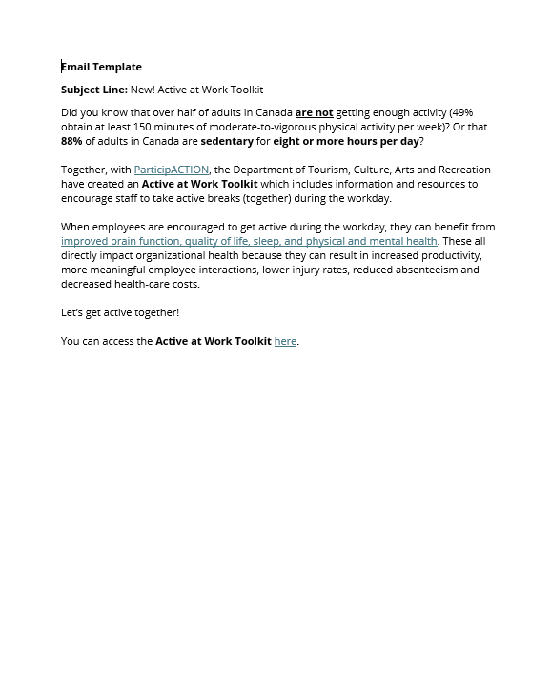
Employer Email Template
Use this email template to encourage staff to take active breaks together during the workday.

Slide 10


1 Minute

Slide 11


PowerPoint Slides
Insert these slides into PPT presentations to encourage 1-minute active breaks. Set a timer for 1 minute and pick an active exercise for everyone to do! Jumping jacks, stretching, walk around, etc.

Slide 12

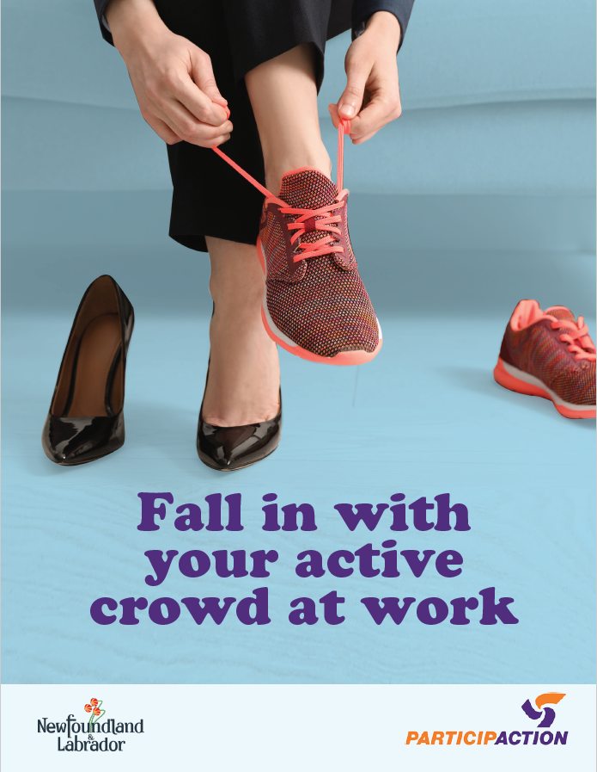
Posters
Print and place these posters around your workplace to encourage your colleagues to squeeze physical activity into their workdays.

Slide 13
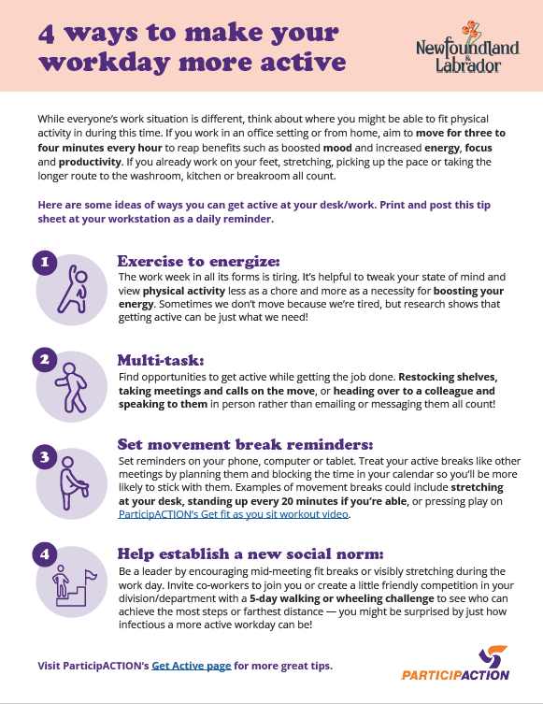
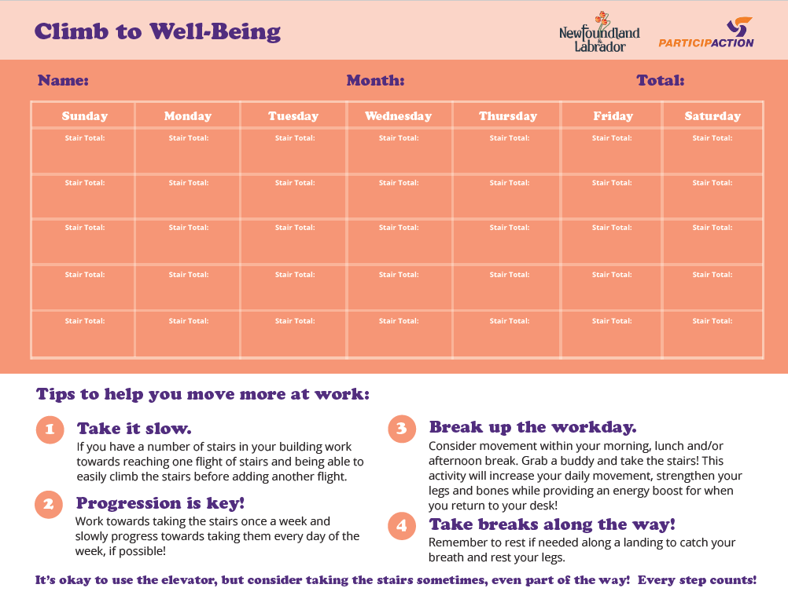
Employee Handouts
Print and post this tip sheet at your workstation to remind you of ways to get active at your desk.
Use the Climb to Well-Being calendar to keep track of how many stairs you climb in a month.

Slide 14
Additional Resources
For more videos and supports:
Visit ParticipACTION’s “Sneak It In” page for more tips on how to squeeze physical activity into your workday.
Visit ParticipACTION’s “Get Active” page for tips on how to start your own active group, to find fitness classes near you and to watch exercise videos.
Read ParticipACTION’s blog post, “Why you should fall in with an active crowd and 5 tips to help you find one”.

Slide 15

Where can I access the toolkit?
The Active at Work Toolkit will be located on the Government of Newfoundland and Labrador’s Department of Tourism, Culture, Arts and Recreation Website at the link below.
http://www.gov.nl.ca/tcar/recreation-an-sport/active-at-work-toolkit

Slide 16

Questions?

Slide 17
Appendix

Slide 18

1 Minute

Slide 19
1 Minute

